Slide 1
Module 9 Email Web and Secure Software Part 1

Slide 2
Module 9 Learning Objectives
On successful completion of this module, you should be able to:
describe security issues associated with email and implement appropriate security practices
describe security issues associated with instant messaging protocols
describe the functioning of SSL/TLS protocol suite
explain web applications plugins and associated security issues
describe secure file transfer options
explain directory usage for data retrieval
explain scripting and other Internet options which are security concerns
use of cookies to maintain parameters between web pages
examine web based application security issues
describe how secure coding can be incorporated into software development processing
list major causes of coding errors and their root causes
describe good software development practices and explain how they impact on application security
describe how using a software development process enforces security inclusion in a software development project.
list application hardening technique

Slide 3
Module 9 Learning Resources
Conklin et al. 2016, Principles of Computer Security: 4th edn
The readings from the textbook for Module 9 are:
Chapter 16 – Email and Instant Messaging pp. 504-529
Chapter 17 Web components pp. 530-557 and
Chapter 18 Secure Software Development pp. 558-583

Slide 4
Key Terms
AOL Instant Messenger (AIM)
Botnet
DomainKeys Identified Mail (DKIM)
E-mail
E-mail hoax
Encryption
Instant messaging (IM)
Mail delivery agent (MDA)
Mail relaying
Mail transfer agent (MTA)
Mail user agent (MUA)
Multipurpose Internet Mail Extensions (MIME)
Open relay
Notes:
AOL Instant Messenger – (AIM) A way to find people of like interests online. Modeled after earlier chat programs.
Botnet – A term for a collection of software robots, or bots, that runs autonomously and automatically and commonly invisibly in the background. The term is most often associated with malicious software, but it can also refer to the network of computers using distributed computing software.
DomainKeys Identified Mail (DKIM) – An authentication system for e-mail designed to detect spoofing of e-mail addresses.
E-mail – Started with mailbox programs on early time-sharing machines, allowing researchers to leave messages for others using the same machine.
E-mail hoax – E-mails that travel from user to user because of the compelling story contained in them.
Encryption – The reversible process of rendering data unreadable through the use of an algorithm and a key.
Instant messaging (IM) – A text-based method of communicating over the Internet.
Mail delivery agent (MDA) – The recipient’s mail server.
Mail relaying – Similar to dropping a letter off at a post office instead of letting the postal carrier pick it up at your mailbox. On the Internet, that consists of sending e-mail from a separate IP address, making it more difficult for the mail to be traced back to you.
Mail transfer agent (MTA) – The mail server
Mail user agent (MUA) – The application on the sender’s machine.
Multipurpose Internet Mail Extensions (MIME) – A standard that describes how to encode and attach non-textual elements in an e-mail.
Open relay – A mail server that receives and forwards mail from outside sources.

Slide 5
Key Terms (continued)
Pretty Good Privacy (PGP)
Real-time Blackhole List (RBL)
Secure/Multipurpose Internet Mail Extensions (S/MIME)
Sender ID Framework (SIDF)
Sender Policy Framework (SPF)
Simple Mail Transfer Protocol (SMTP)
Spam
Unsolicited commercial e-mail
Notes:
Pretty Good Privacy (PGP) – A popular encryption program that has the ability to encrypt and digitally sign e-mail and files.
Real-time Blackhole List (RBL) – A system that uses DNS information to detect and dump spam e-mails.
Secure/Multipurpose Internet Mail Extensions (S/MIME) – An encrypted implementation of the MIME (Multipurpose Internet Mail Extensions) protocol specification.
Sender ID Framework (SIDF) – Microsoft’s server-based solution to spam.
Sender Policy Framework (SPF) – An e-mail verification system designed to detect spoofed e-mail addresses.
Simple Mail Transfer Protocol (SMTP) – The standard Internet protocol used to transfer e-mail between hosts.
Spam – E-mail that is not requested by the recipient and is typically of a commercial nature. Also known as unsolicited commercial e-mail (UCE).
Unsolicited commercial e-mail – E-mail that is not requested by the recipient and is typically of a commercial nature.

Slide 6
How E-Mail Works
E-mail started with mailbox programs on early time-sharing machines, allowing researchers to leave messages for others using the same machine.
Internet e-mail depends on three primary protocols:
Simple Mail Transfer Protocol (SMTP) is a method by which mail is sent to the server as well as from server to server.
POP3 is a method by which a client computer may connect to a server and download new messages.
IMAP allows the client to retrieve messages from the server; it typically works in greater synchronization than POP3.

Slide 7
How E-Mail Works (continued)
Secure versions of the common communication protocols exist via the STARTTLS method.
STARTTLS is a means of using Transport Layer Security (TLS) to secure a communication channel for text-based communication protocols.
E-mail appears to be a client-to-client communication, between sender and receiver.
In reality, a lot of steps are involved.

Slide 8
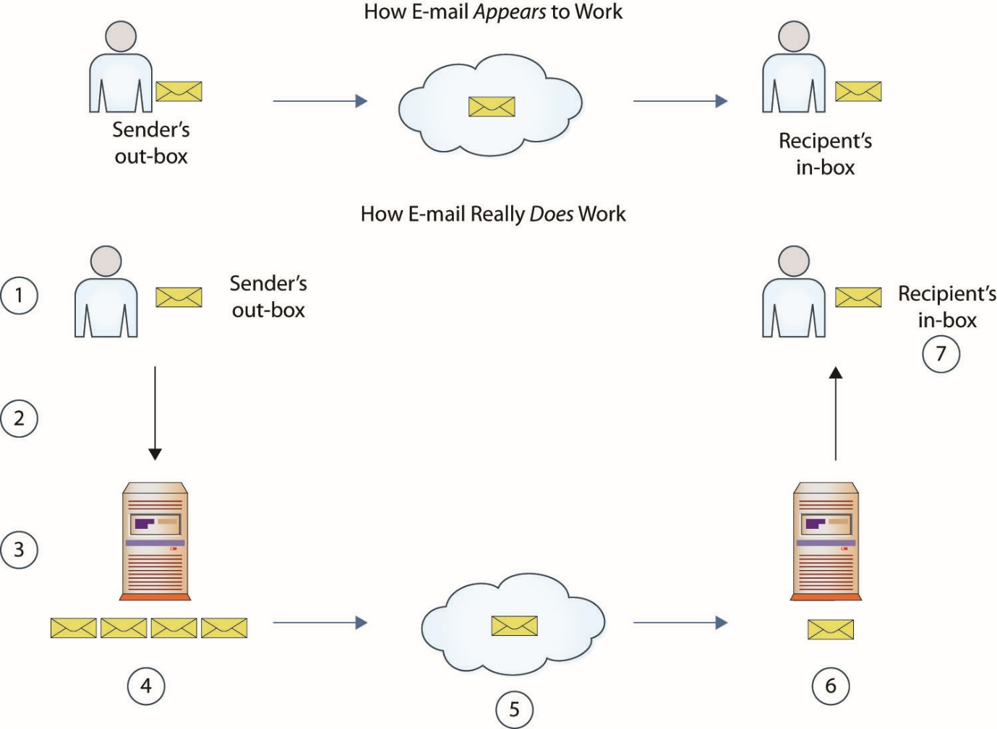
Figure 16.1 How e-mail works
Notes:
In reality, a lot of steps are involved, as shown in Figure 16.1 and described here:
1. A user composes and sends an e-mail from the user’s client machine.
2. The e-mail is sent to the client’s e-mail server. In an Internet service provider (ISP) environment, this could be via the ISP. In the case of web mail, it is the mail service (Gmail, Hotmail/Live, etc.). In a corporate environment it is the corporate mail server.
3. a. The receiving e-mail server scans the e-mail for viruses, malware, and other threats.
3. b. The mail server uses DNS to obtain the recipient e-mail server address via an MX record.
4. The mail server prepares the e-mail for transit across the Internet to the recipient’s mail server.
5. The e-mail is routed across the Internet.
6. The receiving e-mail server scans the e-mail for viruses, malware, and other threats.
7. The e-mail is passed to the recipient’s in-box, where it can be read.

Slide 9
How E-Mail Works (continued)
In technical terms, the application on the sender’s machine is referred to as a mail user agent (MUA), and the mail server is a mail transfer agent (MTA).
The recipient’s mail server is referred to as a mail delivery agent (MDA).
These terms are used when discussing mail transfers to provide accuracy in the conversation.
Notes:
For communication from the MUA to the MTA, SMTP (port 25) is used, and communication from MTA to MTA is also SMTP. The protocol used for communication from the MDA to the MUA on the recipient machine is typically POP/IMAP.

Slide 10
E-Mail Structure
E-mail is structured in two elements, a header and the body.
The entire message is sent via plain ASCII text, with attachments included using Base64 encoding.
The e-mail header provides information for the handling of the e-mail between MUAs, MTAs, and MDAs.
It is important to note that the format of the message and its attachments are in plaintext.

Slide 11
MIME
When a message has an attachment, the protocol used to deliver the message is Multipurpose Internet Mail Extensions (MIME).
This protocol allows the exchange of different kinds of data across text-based e-mail systems.
When MIME is used, it is marked in the header of the e-mail, along with supporting elements to facilitate decoding.

Slide 12
Security of E-Mail
The e-mail hoax has become a regular occurrence.
Internet-based urban legends are spread through e-mail, with users forwarding them in seemingly endless loops around the globe.
People still have not found a good way to block ubiquitous spam e-mails.
E-mail security is ultimately the responsibility of users themselves, because they are the ones who will actually be sending and receiving the messages.
Notes:
E-mail can be used to move a variety of threats across the network. From spam, to viruses, to advanced malware in spear-phishing attacks, e-mail can act as a transmission medium. Spam is the most common attack but is now just a nuisance; the majority is now mostly cleaned up by mail server filters and software.

Slide 13
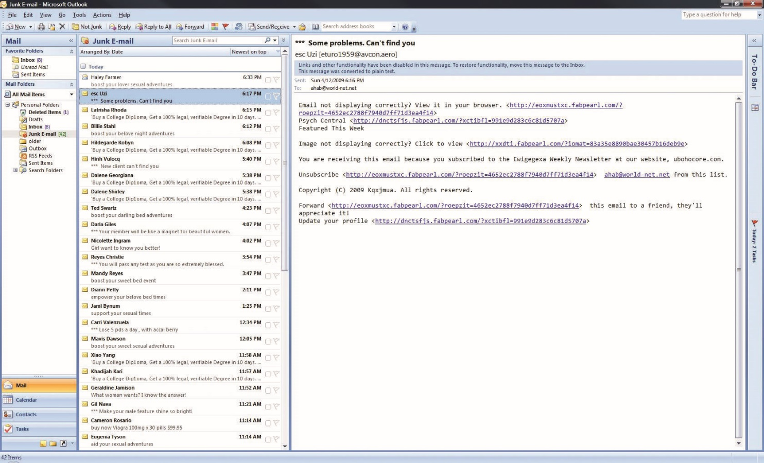
Figure 16.2 A typical list of spam e-mails
Notes:
People still have not found a good way to block ubiquitous spam e-mails (a sampling of which is shown in Figure 16.2), despite the remarkable advance of every other technology.

Slide 14
Security of E-Mail (continued)
Security administrators can give users the tools they need to fight malware, spam, and hoaxes.
Secure/Multipurpose Internet Mail Extensions (S/MIME) and Pretty Good Privacy (PGP) are two popular methods used for encrypting e-mail.
Server-based and desktop-based virus protection can help against malicious code, and spam filters attempt to block all unsolicited commercial e-mail.
E-mail users need to be educated about security.

Slide 15
Security of E-Mail (continued)
Instant messaging (IM), while not part of the e-mail system, is similar to e-mail in many respects, particularly in the sense that it is commonly plaintext and can transmit files.
IM’s handling of files opens the application to virus exploitation just like e-mail.
IM has experienced a boom in popularity in the last few years.

Slide 16
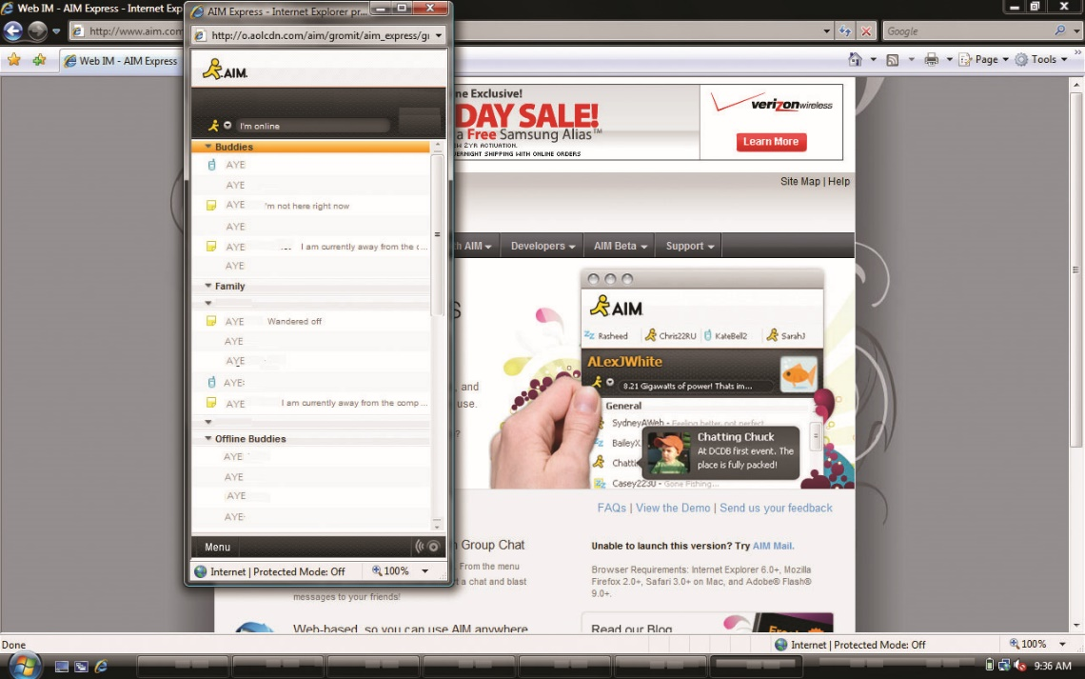
Figure 16.3 AOL Instant Messenger is a popular instant messaging program.
Notes:
IM has experienced a boom in popularity in the last few years, so we will look at some popular IM programs later in this chapter, such as AOL Instant Messenger, shown in Figure 16.3.

Slide 17
Malicious Code
Viruses and worms are popular programs because they make themselves popular.
Because the e-mail protocol permits users to attach files to e-mail messages, viruses can travel by e-mail from one local network to another, anywhere on the Internet.
This changed the nature of virus programs, since they once were localized but now could spread virtually everywhere.
E-mail gave the virus a global reach.
Notes:
Exam Tip: Viruses and worms both can carry malicious payloads and cause damage. The difference is in how they are transmitted: viruses require a file to infect, whereas worms can exist independently of a file.
The advent of computer networks was a computer virus writer’s dream, allowing viruses to attempt to infect every network share to which the computer was attached. This extended the virus’s reach from a set of machines that might share a floppy disk to every machine on the network. Because the e-mail protocol permits users to attach files to e-mail messages (see Figure 16.4), viruses can travel by e-mail from one local network to another, anywhere on the Internet. This changed the nature of virus programs, since they once were localized but now could spread virtually everywhere. E-mail gave the virus a global reach.
When active content was designed for the Web, in the form of Java and ActiveX scripts, these scripts were interpreted and run by the web browser. E-mail programs also would run these scripts, and that’s when the trouble began. Some e-mail programs, most notably Microsoft Outlook, use a preview pane, which allows users to read e-mails without opening them in the full screen (see Figure 16.5).

Slide 18
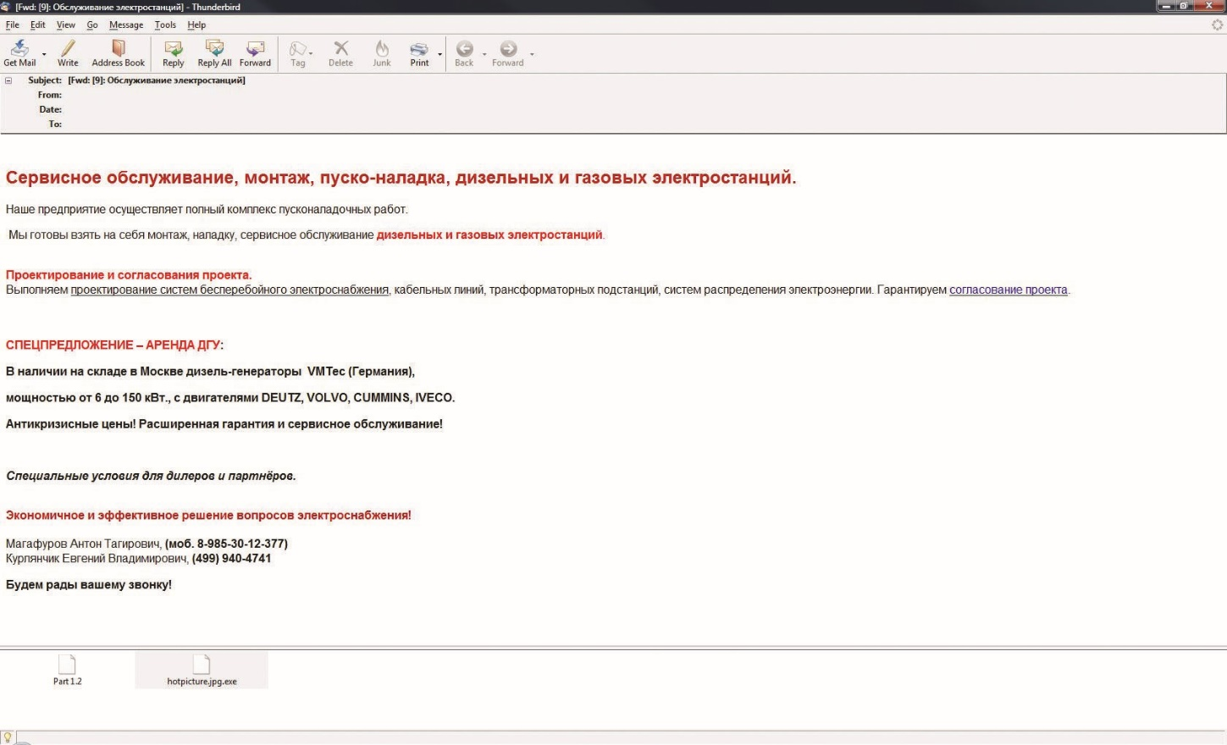
Figure 16.4 Viruses commonly spread through e-mail attachments.
Notes:
Because the e-mail protocol permits users to attach files to e-mail messages (see Figure 16.4), viruses can travel by e-mail from one local network to another, anywhere on the Internet.

Slide 19
Malicious Code (continued)
When active content was designed for the Web, in the form of Java and ActiveX scripts, these scripts were interpreted and run by the web browser.
E-mail programs also would run these scripts, and that is when the trouble began.
Some e-mail programs, most notably Microsoft Outlook, use a preview pane, which allows users to read e-mails without opening them in the full screen.

Slide 20
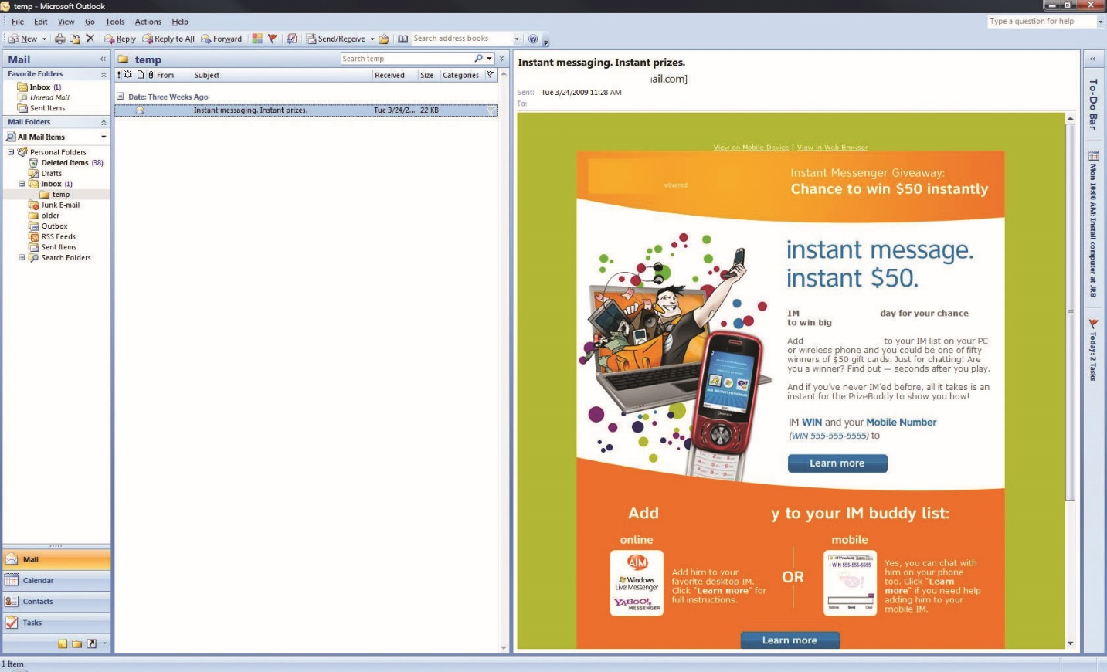
Figure 16.5 The preview pane on the right can execute code in e-mails without opening them.
Notes:
Some e-mail programs, most notably Microsoft Outlook, use a preview pane, which allows users to read e-mails without opening them in the full screen (see Figure 16.5).
Unfortunately, this preview still activates all the content in the e-mail message, and because Outlook supports Visual Basic scripting, it is vulnerable to e-mail worms. A user doesn’t need to run the program or even open the e-mail to activate the worm—simply previewing the e-mail in the preview pane can launch the malicious content. This form of automatic execution was the primary reason for the spread of the ILOVEYOU worm.

Slide 21
Malicious Code (continued)
All malware is a security threat.
Antivirus systems are not a panacea.
Worm prevention relies on patch management.
Viruses are user-launched.
People using the e-mail system create the front line of defense against viruses.
Users need to be educated about virus dangers.
Use localized antivirus scanning programs like AVG.
Notes:
All malware is a security threat, with the several different types having different countermeasures. The antivirus systems that we have used for years have progressed to try and stop all forms of malicious software, but they are not a panacea. Worm prevention also relies on patch management of the operating system and applications. Viruses are user-launched, and since one of the most common transfer methods for viruses is through e-mail, the people using the e-mail system create the front line of defense against viruses. In addition to antivirus scanning of the user’s system, and possibly an e-mail virus filter, users need to be educated about the dangers of viruses.
Although the great majority of users are now aware of viruses and the damage they can cause, more education may be needed to instruct them on the specific things that need to be addressed when a virus is received via e-mail. These can vary from organization to organization and from e-mail software to e-mail software; however, some useful examples of good practices involve examining all e-mails for a known source as well as a known destination, especially if the e-mails have attachments. Strange files or unexpected attachments should always be checked with an antivirus program before execution. Users also need to know that some viruses can be executed simply by opening the e-mail or viewing it in the preview pane. Education and proper administration is also useful in configuring the e-mail software to be as virus resistant as possible—turning off scripting support and the preview pane are good examples. Many organizations outline specific user responsibilities for e-mail, similar to network acceptable use policies. Some examples include using e-mail resources responsibly, avoiding the installation of untrusted programs, and using localized antivirus scanning programs, such as AVG.

Slide 22
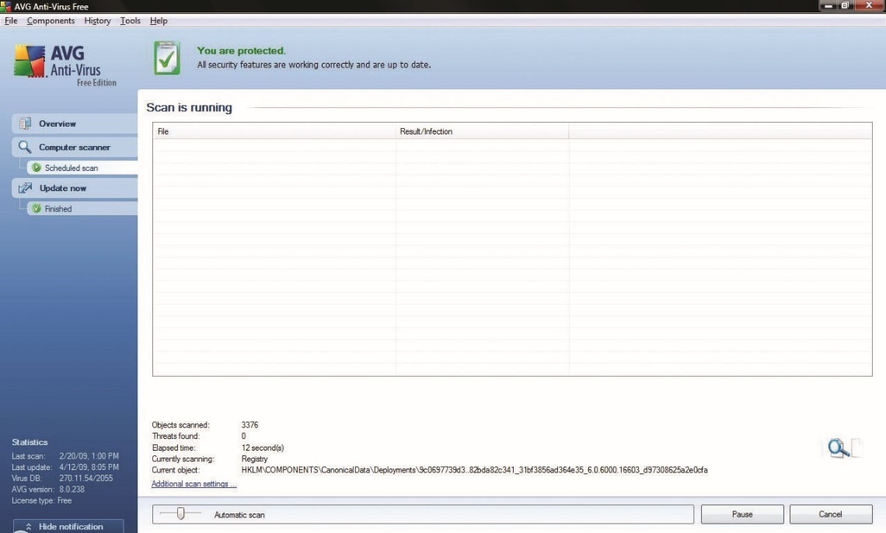

Slide 23
Malicious Code (continued)
Another protection is to carefully create virus scanning procedures.
If possible, perform virus scans on every e-mail as it comes into the company’s e-mail server.
Some users will also attempt to retrieve e-mail offsite from a normal Internet service provider (ISP) account, which can bypass the server-based virus protection,
Every machine should also be protected with a host-based virus protection program that scans all files on a regular basis and performs checks of files upon their execution.

Slide 24
Hoax E-mails
E-mail hoaxes are mostly a nuisance.
They waste time and use Internet bandwidth and server processing time.
E-mail hoaxes are global urban legends, perpetually traveling from one e-mail account to the next, and most have a common theme of some story.
It is important to educate e-mail users.
They should be familiar with a hoax before they go online.
They should know how to search the Internet for hoax information.
Notes:
Warning: Forwarding hoax e-mails and other jokes, funny movies, and non-work-related e-mails at work can be a violation of your company’s acceptable use policy and result in disciplinary actions.
E-mail hoaxes are mostly a nuisance, but they do cost everyone, not only in the time wasted by receiving and reading the e-mails, but also in the Internet bandwidth and server processing time they take up. E-mail hoaxes are global urban legends, perpetually traveling from one e-mail account to the next, and most have a common theme of some story you must tell ten other people about right away for good luck or some virus that will harm your friends unless you tell them
The most important thing to do in this case is educate e-mail users: they should be familiar with a hoax or two before they go online, and they should know how to search the Internet for hoax information. Users need to apply the same common sense on the Internet that they would in real life: If it sounds too outlandish to be true, it probably is a fabrication. The goal of education about hoaxes should be to change user behavior to delete the hoax e-mail and not send it on immediately. Hoaxes are similar to chain letters, but instead of promising a reward, the story in the e-mail is typically what produces the action.

Slide 25
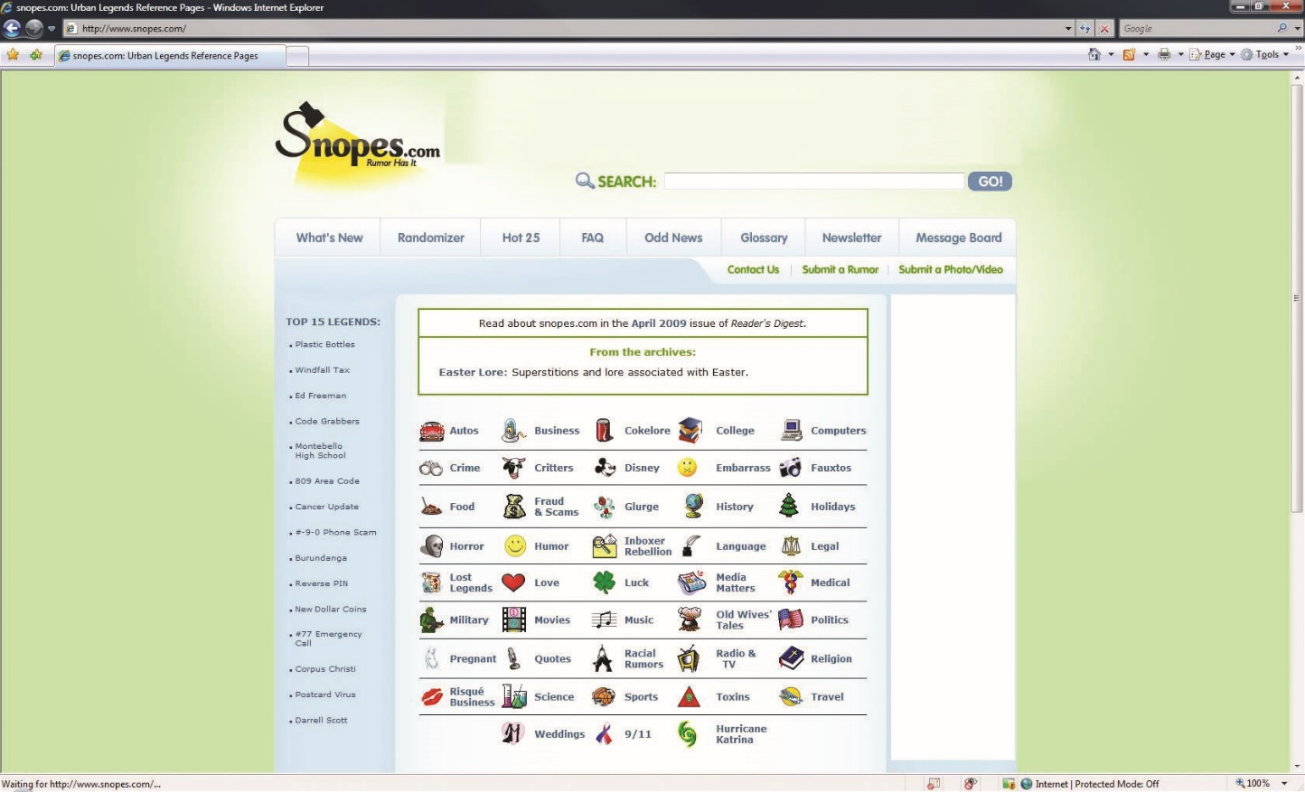
Figure 16.6 Snopes is an online reference for urban legends common in hoax e-mails.
Notes:
Hoaxes have been circling the Internet for many years, and many web sites are dedicated to debunking them, such as Snopes.com (see Figure 16.6).

Slide 26
Unsolicited Commercial E-Mail (Spam)
Spam refers to unsolicited commercial e-mail whose purpose is the same as the junk mail you get in your physical mailbox—it tries to persuade you to buy something.
The term spam comes from a skit on Monty Python’s Flying Circus, where two people are in a restaurant that serves only the potted meat product.
This concept of the repetition of unwanted things is the key to e-mail spam.
Notes:
The first spam e-mail was sent in 1978 by a DEC employee. However, the first spam that really captured everyone’s attention was in 1994, when two lawyers posted a commercial message to every Usenet newsgroup. This was the origin of using the Internet to send one message to as many recipients as possible via an automated program. Commercial e-mail programs have taken over, resulting in the variety of spam that most users receive in their in-boxes every day.

Slide 27
Unsolicited Commercial E-Mail (Spam) (continued)
Botnet researchers have reported that a million–plus infected machines send more than 100 billion spam e-mails every day.
The senders of spam e-mail can generally send the messages for less than a cent apiece.
The amount of spam being transmitted eventually spurred federal authorities into action.
Controlling the Assault of Non-Solicited Pornography and Marketing Act (CAN-SPAM) law
Notes:
Botnet researchers have reported that a million–plus infected machines send more than 100 billion spam e-mails every day. According to the Symantec monthly State of Spam report in July 2009, over 90 percent of e-mail sent worldwide is spam.
The appeal to the people generating the spam is the extremely low cost per advertising impression. The senders of spam e-mail can generally send the messages for less than a cent apiece. This is much less expensive than more traditional direct mail or print advertisements, and this low cost will ensure the continued growth of spam e-mail unless something is done about it.
The amount of spam being transmitted eventually spurred federal authorities into action. In late 2003 the Controlling the Assault of NonSolicited Pornography and Marketing Act (CAN-SPAM) was signed into law. This law gave the Federal Trade Commission (FTC) authority to define the standards of spam e-mail and enforce the other provisions of the act. While several spammers have been caught and prosecuted under this act, it has not been restrictive enough to severely limit spam. This has forced most people to seek out technical solutions to the spam problem.

Slide 28
Unsolicited Commercial E-Mail (Spam) (continued)
Mail relaying is similar to dropping a letter off at a post office instead of letting the postal carrier pick it up at your mailbox.
On the Internet, that consists of sending e-mail from a separate IP address.
SMTP server software is typically configured to accept mail only from specific hosts or domains.
All SMTP software can and should be configured to accept only mail from known hosts, or to known mailboxes; this closes down mail relaying and helps to reduce spam.
Notes:
Mail relaying is similar to dropping a letter off at a post office instead of letting the postal carrier pick it up at your mailbox. On the Internet, that consists of sending e-mail from a separate IP address, making it more difficult for the mail to be traced back to you. SMTP server software is typically configured to accept mail only from specific hosts or domains. All SMTP software can and should be configured to accept only mail from known hosts, or to known mailboxes; this closes down mail relaying and helps to reduce spam.

Slide 29
Unsolicited Commercial E-Mail (Spam) (continued)
Software must be used to combat spam at the recipient’s end.
Spam can be filtered at two places:
At the host itself by the e-mail client software and employing basic pattern matching, focusing on the sender, subject, or text of the e-mail
At the server by filtering spam at the mail server level
Notes:
Since it may not be possible to close all mail relays, and because some spammers will mail from their own mail servers, software must be used to combat spam at the recipient’s end. Spam can be filtered at two places: at the host itself or at the server. Filtering spam at the host level is done by the e-mail client software and usually employs basic pattern matching, focusing on the sender, subject, or text of the e-mail. This fairly effective system uses an inordinate amount of bandwidth and processing power on the host computer, however. These problems can be solved by filtering spam at the mail server level. Many companies offer a dedicated appliance designed as a specialty e-mail server with the primary task of filtering spam. This server typically uses a combination of techniques listed here. It also implements an internal database to allow more granular filtering based upon spam the appliance has already seen.

Slide 30
Unsolicited Commercial E-Mail (Spam) (continued)
The Real-time Blackhole List (RBL) was the first list to utilize the concept of using DNS records to filter, or “blackhole,” spam-sending IP addresses and domains.
While the RBL was the first DNSBL, there are now many blackhole lists.
In addition to the RBL, multiple other DNS-based blacklist services can assist filtering based upon DNS sources of mail.
Notes:
The server-based approach can be beneficial because other methods of filtering spam can be used at the server: pattern matching is still used, but SMTP software can also use a process called Domain Name Service (DNS) blacklisting, or DNSBL. The Real-time Blackhole List (RBL) was the first list to utilize the concept of using DNS records to filter, or “blackhole,” spam-sending IP addresses and domains. Started in 1997, this list was and is maintained in real time specifically for blocking spam e-mail. While the RBL was the first DNSBL, there are now many blackhole lists. The DNSBL service is so popular that many programs, such as sendmail, Postfix, and Eudora Internet Mail Server, include support for it by default.
In addition to the RBL, multiple other DNS-based blacklist services can assist filtering based upon DNS sources of mail. Commercial packages can block spam at the server level using both methods mentioned, maintaining their own blacklists and pattern-matching algorithms.

Slide 31
Unsolicited Commercial E-Mail (Spam) (continued)
Additional techniques exist for server-based spam filtering.
Use a challenge/response system.
Another technique is known as greylisting.
A side benefit of filtering spam at the receiving server is reduced e-mail.
This reduces cost and time of backups.
Spam reduction will also have a significant impact on the e-discovery process.
Notes:
Many additional techniques exist for server-based spam filtering—enough to fill an entire book on the subject. One technique is to use a challenge/response system: once an e-mail is received by a “new” contact, a challenge is sent back to the originating address to confirm the contact. Since spammers send e-mails in bulk, the response mechanism is too cumbersome and they will not respond.
Another technique is known as greylisting. When an e-mail is received, it is bounced as a temporary rejection. SMTP servers that are RFC 5321–compliant will wait a configurable amount of time and attempt retransmission of the message. Obviously, spammers will not retry sending of any messages, so spam is reduced.
All these techniques have advantages and disadvantages, and most people will run some combination of techniques to attempt to filter as much spam as possible while not rejecting legitimate messages.
A side benefit of filtering spam at the receiving server is reduced e-mail. In enterprises, performing backups of information is a significant task. Backups are size dependent, both in cost and time, and reducing e-mail by eliminating spam can have significant impacts on e-mail backups. Spam reduction will also have a significant impact on the e-discovery process, as it reduces the quantity of material that needs to be searched. E-discovery is a term for electronic discovery, the electronic component of a legal discovery process. The discovery process is court mandated and, when applied to a corporate environment, can cause the shutdown of corporate operations until the process is complete. For this reason, anything that makes the process easier or faster will benefit the corporation.

Slide 32
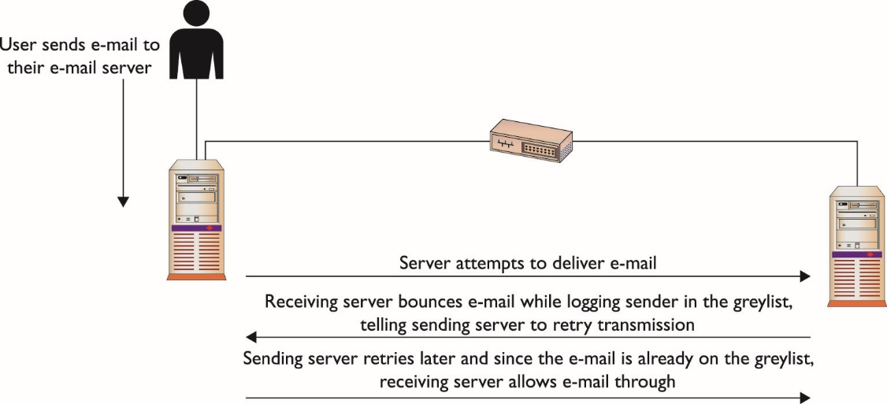
Notes:
Another technique is known as greylisting. When an e-mail is received, it is bounced as a temporary rejection. SMTP servers that are RFC 5321–compliant will wait a configurable amount of time and attempt retransmission of the message. Obviously, spammers will not retry sending of any messages, so spam is reduced.

Slide 33
Unsolicited Commercial E-Mail (Spam) (continued)
Spam URI Real-time Block Lists (SURBL) detect unwanted e-mail based on invalid or malicious links within a message.
Using a SURBL filter is a valuable tool to protect users from malware and phishing attacks.
Not all mail servers support SURBL, but this technology shows promise in the fight against malware and phishing.

Slide 34
Sender ID Framework
Microsoft offers another server-based solution to spam, called the Sender ID Framework (SIDF).
SIDF attempts to authenticate messages by checking the sender’s domain name against a list of IP addresses authorized to send e-mail by the domain name listed.
This list is maintained in a text (TXT) record published by the DNS, called a Sender Policy Framework (SPF) record.
Notes:
So when a mail server receives an e-mail, it will check the sender’s domain name in the DNS; if the outbound server’s IP matches, the message gets a “pass” rating by SIDF. This is similar to the idea that routers should drop any outbound port 25 traffic that does not come from known e-mail servers on the subnet managed by the router. However, the SIDF system handles the authentication of the e-mail server when it is received, not when it is sent. This system still allows wasted bandwidth from the sender of the message to the receiver, and since bandwidth is increasingly a metered service, this means the cost of spam is still paid by the recipient. The SPF check ensures that the sending MTA is allowed to send mail on behalf of the sender’s domain name. When SPF is activated on your server, the sending server’s MX record (the DNS Mail Exchange record) is validated before message transmission takes place.
These methods can take care of up to 90 percent of the junk mail clogging our networks, but they cannot stop it entirely. Better control of port 25 traffic is required to slow the tide of spam hitting our in-boxes. This would stop spammers using remote open relays and, hopefully, prevent many users from running unauthorized e-mail servers of their own. Because of the low cost of generating spam, until serious action is taken, or spam is somehow made unprofitable, it will remain with us.

Slide 35
DomainKeys Identified Mail
DomainKeys Identified Mail (DKIM) is an e-mail validation system employed to detect e-mail spoofing.
DKIM operates by providing a mechanism to allow receiving MTAs to check that incoming mail is authorized and the e-mail (including attachments) has not been modified during transport.
It does this through a digital signature included with the message that can be validated by the recipient using the signer’s public key published in the DNS.
Notes:
DomainKeys Identified Mail (DKIM) is an e-mail validation system employed to detect e-mail spoofing. DKIM operates by providing a mechanism to allow receiving MTAs to check that incoming mail is authorized and that the e-mail (including attachments) has not been modified during transport. It does this through a digital signature included with the message that can be validated by the recipient using the signer’s public key published in the DNS. DKIM is the result of the merging of two previous methods, DomainKeys and Identified Internet Mail. DKIM is the basis for a series of IETF standards-track specifications and is used by AOL, Gmail, and Yahoo mail. Any mail from these organizations should carry a DKIM signature.

Slide 36
DomainKeys Identified Mail (continued)
DKIM is the result of the merging of two previous methods, DomainKeys and Identified Internet Mail.
DKIM is the basis for a series of IETF standards-track specifications and is used by AOL, Gmail, and Yahoo mail.
Any mail from these organizations should carry a DKIM signature.

Slide 37
Mail Encryption
E-mail suffers from a more important security—the lack of confidentiality, or, as it is sometimes referred to, privacy.
E-mail has always been a plaintext protocol.
Any attacker at a choke point in the network could read all e-mail passing through that network segment.
Some tools can be used to solve this problem by using encryption on the e-mail’s content.
The first method is S/MIME and the second is PGP.
Notes:
When many people first got onto the Internet, they heard a standard lecture about not sending anything through e-mail that they wouldn’t want posted on a public bulletin board. Part of the reason for this was that e-mail is sent with the clear text of the message exposed to anyone who is sniffing the network. Any attacker at a choke point in the network could read all e-mail passing through that network segment.

Slide 38
S/MIME
Secure/Multipurpose Internet Mail Extensions (S/MIME) is a secure implementation of the MIME protocol specification.
MIME was created to allow Internet e-mail to support new and more creative features.
MIME handles audio files, images, applications, and multipart e-mails.
MIME allows e-mail to handle multiple types of content in a message, including file transfers.
S/MIME was developed by RSA Data Security and uses the X.509 format for certificates.
Notes:
The original e-mail RFC specified only text e-mail, so any non-text data had to be handled by a new specification—MIME. MIME handles audio files, images, applications, and multipart e-mails. MIME allows e-mail to handle multiple types of content in a message, including file transfers. Every time you send a file as an e-mail attachment, you are using MIME. S/MIME takes this content and specifies a framework for encrypting the message as a MIME attachment.
S/MIME was developed by RSA Data Security and uses the X.509 format for certificates. The specification supports both 40-bit RC2 and 3DES for symmetric encryption. The protocol can affect the message in one of two ways: the host mail program can encode the message with S/MIME, or the server can act as the processing agent, encrypting all messages between servers.
The host-based operation starts when the user clicks Send; the mail agent then encodes the message using the generated symmetric key. Then the symmetric key is encoded with the remote user’s public key for confidentiality or signed with the local user’s private key for authentication/nonrepudiation. This enables the remote user to decode the symmetric key and then decrypt the actual content of the message. Of course, all of this is handled by the user’s mail program, requiring the user simply to tell the program to decode the message. If the message is signed by the sender, it will be signed with the sender’s public key, guaranteeing the source of the message. The reason that both symmetric and asymmetric encryption are used in the mail is to increase the speed of encryption and decryption. As encryption is based on difficult mathematical problems, it takes time to encrypt and decrypt. To speed this up, the more difficult process, asymmetric encryption, is used only to encrypt a relatively small amount of data, the symmetric key. The symmetric key is then used to encrypt the rest of the message.

Slide 39
S/MIME (continued)
The S/MIME process of encrypting e-mails provides integrity, privacy, and, if the message is signed, authentication.
Several popular e-mail programs support S/MIME.
These include Outlook and Windows Mail.
They both manage S/MIME keys and functions through the E-mail Security screen.
Trusted authorities are needed to ensure the senders are who they claim to be, an important part of authentication.

Slide 40
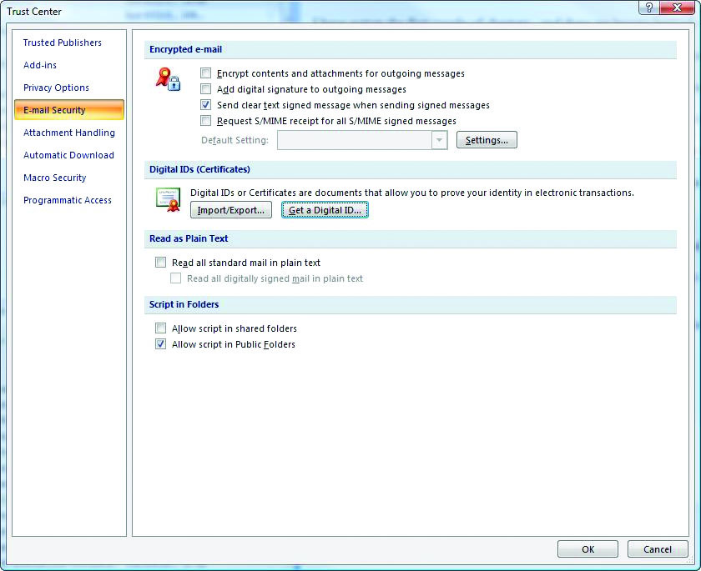
Figure 16.7 S/MIME options in Outlook
Notes:
Several popular e-mail programs support S/MIME, including the popular Microsoft products Outlook and Windows Mail. They both manage S/MIME keys and functions through the E-mail Security screen, shown in Figure 16.7. This figure shows the different settings that can be used to encrypt messages and use X.509 digital certificates. This allows interoperability with web certificates, and trusted authorities are available to issue the certificates. Trusted authorities are needed to ensure the senders are who they claim to be, an important part of authentication.

Slide 41
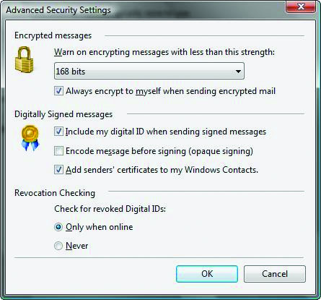
Figure 16.8 S/MIME options in Windows Mail
Notes:
In Windows Mail, the window is simpler (see Figure 16.8), but the same functions of key management and secure e-mail operation are available.

Slide 42
S/MIME (continued)
S/MIME’s implementation can be problematic.
User can select low-strength (40-bit) encryption.
Bugs can exist in the software itself.
Notes:
While S/MIME is a good and versatile protocol for securing e-mail, its implementation can be problematic. S/MIME allows the user to select low-strength (40-bit) encryption, which means a user can send a message that is thought to be secure but that can be more easily decoded than messages sent with 3DES encryption.
Also, as with any protocol, bugs can exist in the software itself. Just because an application is designed for security does not mean that it, itself, is secure. Despite its potential flaws, however, S/MIME is a tremendous leap in security over regular e-mail.

Slide 43
PGP
Pretty Good Privacy (PGP) implements e-mail security in a similar fashion to S/MIME.
PGP uses completely different protocols.
The basic framework is the same.
PGP has plug-ins for many popular e-mail programs, including Outlook and Mozilla’s Thunderbird.
These plug-ins handle the encryption and decryption behind the scenes, and all that the user must do is enter the encryption key’s passphrase to ensure that they are the owner of the key.
Notes:
Pretty Good Privacy (PGP) implements e-mail security in a similar fashion to S/MIME, but PGP uses completely different protocols.
The basic framework is the same:
The user sends the e-mail, and the mail agent applies encryption as specified in the mail program’s programming. The content is encrypted with the generated symmetric key, and that key is encrypted with the public key of the recipient of the e-mail for confidentiality. The sender can also choose to sign the mail with a private key, allowing the recipient to authenticate the sender. Currently, PGP supports public key infrastructure (PKI) provided by multiple vendors, including X.509 certificates and Lightweight Directory Access Protocol (LDAP) key sources such as Microsoft’s Active Directory.

Slide 44
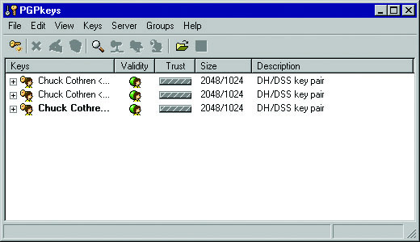
Figure 16.9 PGP key management
Notes:
In Figure 16.9, you can see how PGP manages keys locally in its own software. This is where a user stores not only local keys, but also any keys that were received from other users. A free key server is available for storing PGP public keys. PGP can generate its own keys using either Diffie-Hellman or RSA, and it can then transmit the public keys to the PGP LDAP server so other PGP users can search for and locate your public key to communicate with you. This key server is convenient, as each person using PGP for communications does not have to implement a server to handle key management. For the actual encryption of the e-mail content itself, PGP supports International Data Encryption Algorithm (IDEA), 3DES, and Carlisle Adams and Stafford Tavares (CAST) for symmetric encryption. PGP provides pretty good security against brute-force attacks by using a 3DES key length of 168 bits, an IDEA key length of 128 bits, and a CAST key length of 128 bits. All of these algorithms are difficult to brute-force with existing hardware, requiring well over a million years to break the code. While this is not a promise of future security against brute-force attacks, the security is reasonable today.

Slide 45
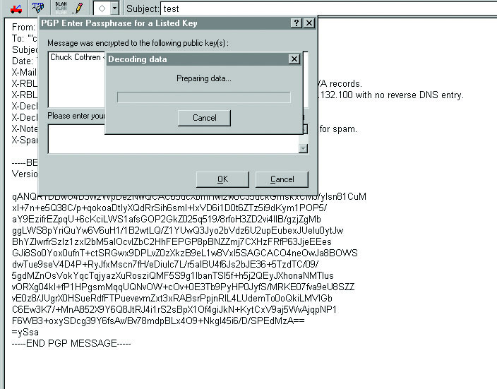
Figure 16.10 Decoding a PGP-encoded message
Notes:
In Figure 16.10, you can see the string of encrypted text that makes up the MIME attachment. This text includes the encrypted content of the message and the encrypted symmetric key. You can also see that the program does not decrypt the message upon receipt; it waits until instructed to decrypt it. PGP also stores encrypted messages in the encrypted format, as does S/MIME. This is important, since it provides end-to-end security for the message.

Slide 46
PGP (continued)
PGP is not problem-free.
You must keep the software up to date and fully patched.
There are concerns about key recovery or key escrow.
Additional Decryption Key (ADK) used an additional public key stacked upon the original public key.
ADK not always controlled by a properly authorized organization, and the danger exists for someone to add an ADK and then distribute it to the world.
Users believe message can only be read by the first party, but message can be read by the third party who modified the key.
Notes:
Like S/MIME, PGP is not problem-free. You must be diligent about keeping the software up to date and fully patched, because vulnerabilities are occasionally found. For example, a buffer overflow was found in the way PGP was handled in Outlook, causing the overwriting of heap memory and leading to possible malicious code execution. There is also a lot of discussion about the way PGP handles key recovery, or key escrow. PGP uses what’s called an Additional Decryption Key (ADK), which is basically an additional public key stacked upon the original public key. An ADK, in theory, would give the proper organization a private key that would be used to retrieve the secret messages. In practice, the ADK is not always controlled by a properly authorized organization, and the danger exists for someone to add an ADK and then distribute it to the world. This creates a situation in which other users will be sending messages that they believe can be read only by the first party, but that can actually be read by the third party who modified the key.

Slide 47
Instant Messaging
AOL Instant Messenger (AIM) was conceived as a way to find people of like interests online.
It was modeled after earlier chat programs.
With GUI features and enhanced ease of use, it quickly became popular enough for AOL to release to regular users of the Internet.
Along with several competing programs, AIM was feeding the tremendous growth of the instant messaging segment.
Ease of use was paramount and security was not a priority.
Notes:
The programs had to appeal to a wide variety of users, so ease of use was paramount, and security was not a priority. Now that people are accustomed to IM applications, they see the benefit of using them not only for personal chatting on the Internet, but also for legitimate business use. When people install these applications, they unwittingly expose the corporate network to security breaches through many of the same malicious software problems as e-mail. Instant messages traverse the Internet in plaintext and also cross third-party servers—be it Yahoo, Skype, Google, or AOL.

Slide 48
Instant Messaging (continued)
People are accustomed to IM applications.
IM offers the benefit of personal chatting on the Internet, and legitimate business use.
Installation unwittingly exposes the corporate network to security breaches.
Instant messages traverse the Internet in plaintext and also cross third-party servers.

Slide 49
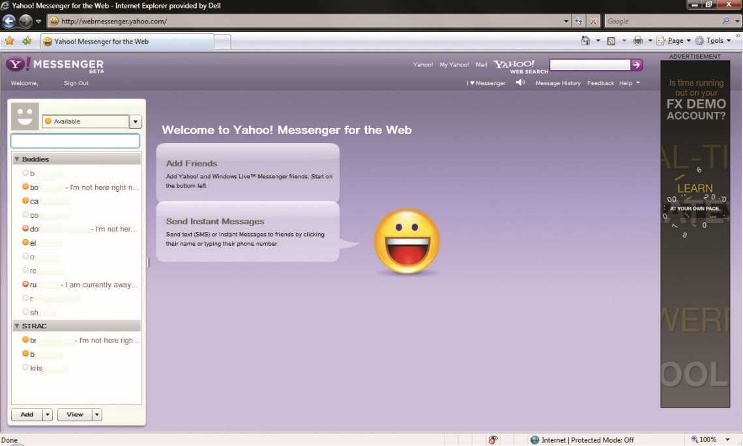

Slide 50
Instant Messaging (continued)
IM opens several holes in a system’s security.
The program has to attach to a server, typically announcing the IP address of the originating client.
IM identifies a specific user associated with the IP address, making attacks more likely.
For users to send you messages, the program is forced to announce your presence on the server.
User is now displaying that his computer is on and is possibly broadcasting the source IP address.
Notes:
IM programs are designed to attach to a server, or a network of servers, and allow you to talk with other people on the same network of servers in near real time. The nature of this type of communication opens several holes in a system’s security. First, the program has to attach to a server, typically announcing the IP address of the originating client. This is not a problem in most applications, but IM identifies a specific user associated with the IP address, making attacks more likely. Also associated with this fact is that for other users to be able to send you messages, the program is forced to announce your presence on the server. So now a user is displaying that his or her computer is on and is possibly broadcasting the source IP address to anyone who is looking. This problem is compounded by the tendency for people to run these programs in the background so that they don’t miss any messages.

Slide 51
Instant Messaging (continued)
Popular IM clients were not implemented with security in mind.
All support sending files as attachments.
Few currently support encryption.
Currently, none have a virus scanner built into the file-sharing utility.

Slide 52
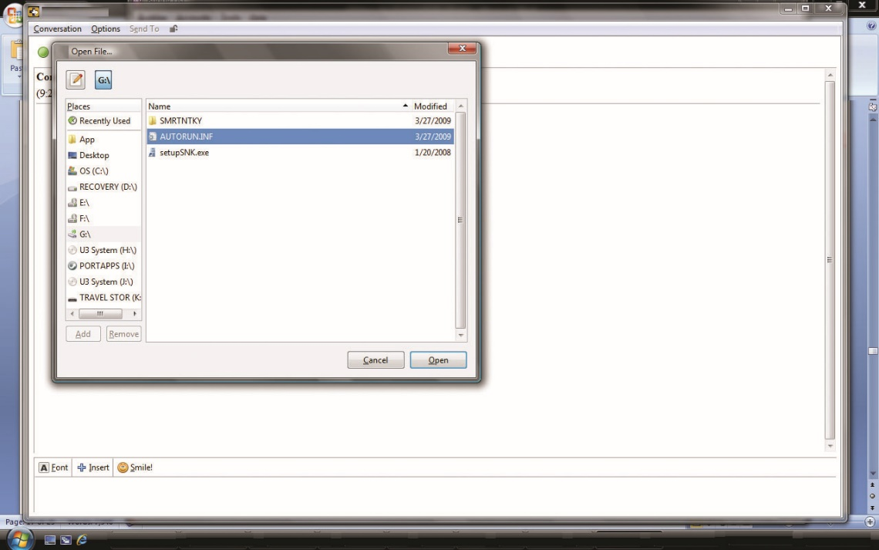
An example of a file-sharing utility as part of an IM program

Slide 53
Chat Programs Security Risks
Chat programs produce security risks.
Administrators have no control over the quality of the files being sent, and there is no monitoring of the original sources of those files.
The only authentication for the files is the human interaction between the two users in question.
A user can also be persuaded autonomously to download and run a file via IM.
Notes:
File sharing in any form must be a carefully handled application to prevent the spread of viruses and other malicious code. Chat programs produce security risks, because the sharing is done ad hoc between end users, administrators have no control over the quality of the files being sent, and there is no monitoring of the original sources of those files. The only authentication for the files is the human interaction between the two users in question. This kind of vulnerability coupled with a social engineering attack can produce dramatic enough results that the CERT Coordination Center (CERT/CC) was compelled to issue an incident note (CERT Incident Note IN-2002-03: Social Engineering Attacks via IRC and Instant Messaging). This personal type of authentication was abused, tricking people into downloading and executing backdoor or Trojan horse programs.
A user can also be persuaded autonomously to download and run a file via IM. Several worms exist that attempt, via IM, to get users to download and run the payload. W32.pipeline uses AIM to install a rootkit. Goner, running via ICQ, another IM program, asks users to download a screen saver. Choke, spreading via MSN/Windows Live Messenger, attempts to get users to download a game; if the game is downloaded, the worm attempts to spread to any user the infected user chats with. These worms and others all depend on user interaction to run the payload. This file-sharing mechanism bypasses all the server-side virus protection that is part of most organizations’ e-mail infrastructure. This pushes more of the responsibility for malware protection onto the local users’ antivirus system. This can be problematic for users who do not regularly update their systems or who fail to perform regular antivirus scans.

Slide 54
Chat Programs Security Risks (continued)
IM programs lack support for encryption.
Third-party programs will add encryption as a plug-in.
Confidential business information may be exposed.
IM application is typically installed by the end user, without the knowledge of the administrator.
The chat protocols have default TCP ports.
If not available, rogue apps may scan all ports looking for one that is allowed out of the firewall.
Notes:
One of the largest problems with IM programs is the lack of support for encryption. AIM, ICQ, Skype, and Yahoo Messenger all currently do not natively support encryption of the text messages traveling between users. However, some third-party programs will add encryption as a plug-in. The lack of encryption was not a significant concern while these IM programs were still used primarily for personal communication, but with businesses moving to adopt the systems, people are not aware of the infrastructure difference between IM and e-mail. Intracompany e-mail never leaves the company’s network, but an intracompany instant message typically will do so unless the organization purchases a product and operates an internal IM server. This can and does expose large amounts of confidential business information to anyone who is physically in a spot to monitor and has the desire to capture the traffic.
The protocols used for these chat applications have default TCP ports— AIM uses 5190, Jabber uses 5222 and 5269, Yahoo Messenger uses 5050, and MSN/Windows Live Messenger uses 1863. Some IM applications have been programmed for use as rogue apps. In the event that they can’t reach a server on the default ports, they begin to scan all ports looking for one that is allowed out of the firewall. As these applications can connect on any port, including common ones such as Telnet port 23 and HTTP port 80, they are very hard to control. These types of security risks go above and beyond the routine security holes generated in IM software that arise as in any other piece of software, through coding errors.

Slide 55
Modern Instant Messaging Systems
The best ways to protect yourself on an IM network are similar to those for other Internet applications:
Avoid communication with unknown persons, avoid running any program you are unsure of, and do not write anything you wouldn’t want posted with your name on it.
As the social aspect of the Web grows, so do the instant sharing systems connecting users in social webs.
The main security threat on most of these is information disclosure.
Notes:
Instant messaging also plays a role in today’s social media–driven world. There are many very popular “messaging systems” that are in popular use today, including Snapchat, Instagram, Jabber, Tumblr, WhatsApp, and more. These are instant sharing systems that allow user bases to share files, pictures, and videos between users. Each of these systems has large numbers of users and literally billions of transferred items every year. As the social aspect of the Web grows, so do the instant sharing systems connecting users in social webs. Apple has its own messaging service, as does Android, and apps exist for a wide range of different “messaging” systems.
Any list of messaging apps is one that will become outdated rather rapidly, but at the time this book goes to press the list would include the following:
LINE
Viber
WhatsApp (now part of Facebook)
Facebook Messenger
Snapchat
Kik
Tango
WeChat
Instagram
Jabber
Tumblr
The main security threat on most of these is information disclosure. As they can be used from mobile devices outside of an enterprise network, there is the possibility for information to be captured and released across these platforms. For this reason, one of the security policies of high-security facilities is to not allow personal devices.

Slide 56
Module 9 Email Web and Secure Software Web Components Part 2

Slide 57

Web Components
Chapter 17

Slide 58
Key Terms
Active Server Pages (ASP)
ActiveX
ASP.NET
Authenticode
Buffer overflow
Code signing
Common Gateway Interface (CGI)
Cookie
File Transfer Protocol (FTP)
Hypertext Markup Language (HTML)
Inlining
Internet Engineering Task Force (IETF)
Java
Notes:
Active Server Pages (ASP) – Microsoft’s server-side script technology for dynamically generated web pages.
ActiveX – A Microsoft technology that facilitates rich Internet applications, and therefore extends and enhances the functionality of Microsoft Internet Explorer. Like Java, ActiveX enables the development of interactive content. When an ActiveX-aware browser encounters a web page that includes an unsupported feature, it can automatically install the appropriate application so the feature can be used.
ASP.NET – A technology that operates in much the same fashion as CGI: it allows programs to be run outside the web server and to return data to the web server to be served to end users via a web page.
Authenticode – Microsoft code-signing technology used to provide integrity and attribution on software.
Buffer overflow – A specific type of software coding error that enables user input to overflow the allocated storage area and corrupt a running program.
Code signing – The application of digital signature technology to software for purposes of integrity and authentication control.
Common Gateway Interface (CGI) – An older, outdated technology used for server-side execution of programs on web sites.
Cookie – Information stored on a user’s computer by a web server to maintain the state of the connection to the web server. Used primarily so preferences or previously used information can be recalled on future requests to the server.
File Transfer Protocol (FTP) – An application-level protocol used to transfer files over a network connection.
Hypertext Markup Language (HTML) – A protocol used to mark up text for use across HTTP.
Inlining – Using an embedded control from another site with or without the other site’s permission.
Internet Engineering Task Force (IETF) – A large international community of network designers, operators, vendors, and researchers, open to any interested individual concerned with the evolution of the Internet architecture and the smooth operation of the Internet. The actual technical work of the IETF is done in its working groups, which are organized by topic into several areas (such as routing, transport, and security). Much of the work is handled via mailing lists, with meetings held three times per year.
Java – A computer language invented by Sun Microsystems as an alternative to Microsoft’s development languages. Designed to be platform-independent and based on C, Java offered a low learning curve and a way of implementing programs across an enterprise, independent of platform.

Slide 59
Key Terms (continued)
JavaScript
Lightweight Directory Access Protocol (LDAP)
PHP
Plug-in
Secure Sockets Layer (SSL)
Server-side scripting
SSL stripping attack
Transport Layer Security (TLS)
Uniform Resource Locator (URL)
X.500
Notes:
JavaScript – A scripting language developed by Netscape and designed to be operated within a browser instance. JavaScript works through the browser environment. The primary purpose of JavaScript is to enable features such as validation of forms before they are submitted to the server.
Lightweight Directory Access Protocol (LDAP) – This is an application protocol for querying and modifying directory services running over TCP/IP.
PHP – This is a general-purpose scripting language, originally designed for web development to produce dynamic web pages.
Plug-in – These are small application programs that increase a browser’s ability to handle new data types and add new functionality.
Secure Sockets Layer (SSL) – An encrypting layer between the session and transport layers of the OSI model designed to encrypt above the transport layer, enabling secure sessions between hosts.
Server-side scripting – The processing of scripts on the server side of an Internet connection to prevent client tampering with the process.
SSL stripping attack – A specific type of man-in-the-middle attack against SSL.
Transport Layer Security (TLS) – A newer form of SSL that is now an Internet standard.
Uniform Resource Locator (URL) – A specific character string used to point to a specific item across the Internet.
X.500 – The standard format for directory services including LDAP.

Slide 60
Introduction
Before the Web, plenty of methods were used to perform user tasks.
File Transfer Protocol (FTP) was used to move files, and Telnet allowed users access to other machines.
What was missing was the common architecture brought by Berners-Lee:
A common addressing scheme, built around the concept of a Uniform Resource Locator (URL)
The concept of linking documents to other documents by URLs through the Hypertext Markup Language (HTML)

Slide 61
Current Web Components and Concerns
Security concerns can be grouped into three main tasks:
Securing a server that delivers content to users over the Web
Securing the transport of information between users and servers over the Web
Securing the user’s computer from attack over a web connection
Notes:
The usefulness of the Web is due not just to browsers, but also to web components that enable services for end users through their browser interfaces. These components use a wide range of protocols and services to deliver the desired content. From a security perspective, they offer users an easy-to-use, secure method of conducting data transfers over the Internet. Many protocols have been developed to deliver this content, although for most users, the browser handles the details.
From a systems point of view, many security concerns have arisen, but they can be grouped into three main tasks:
Securing a server that delivers content to users over the Web
Securing the transport of information between users and servers over the Web
Securing the user’s computer from attack over a web connection
This chapter presents the components used on the Web to request and deliver information securely over the Internet.

Slide 62
Web Protocols
Requirements for computer communications are handled through protocols.
Agreed-upon sets of rules that allow different vendors to produce hardware and software that can interoperate with hardware and software developed by other vendors
Very important and form the basis by which all the separate parts can work together
Specific instantiation of protocols done through hardware and software components
Notes:
When two people communicate, several things must happen for the communication to be effective: they must use a language that both parties understand, and they must correctly use the language—that is, structure and syntax—to express their thoughts. The mode of communication is a separate entity entirely, for the previous statements are important in both spoken and written forms of communication.

Slide 63
Encryption (SSL and TLS)
Secure Sockets Layer (SSL) is a general-purpose protocol developed by Netscape for managing the encryption of information being transmitted over the Internet.
The Internet Engineering Task Force (IETF) embraced SSL in 1996 through a series of RFCs and named the group of RFCs Transport Layer Security (TLS).
SSL and TLS are essentially the same, although not interchangeable.
SSL is dead and TLS is the path forward, although everyone calls it SSL.
Notes:
SSL began as a competitive feature to drive sales of Netscape’s web server product, which could then send information securely to end users. This early vision of securing the transmission channel between the web server and the browser became an Internet standard. Today, SSL is almost ubiquitous with respect to e-commerce—all browsers support it as do web servers, and virtually all e-commerce web sites use this method to protect sensitive financial information in transit between web servers and browsers.
Starting with SSL 3.0, in 1999, the IETF issued RFC 2246, “TLS Protocol Version 1.0,” followed by RFC 2712, which added Kerberos authentication, and then RFCs 2817 and 2818, which extended TLS to HTTP version 1.1 (HTTP/1.1). Although SSL has been through several versions, TLS begins with an equivalency to SSL 3.0, so today SSL and TLS are essentially the same, although not interchangeable. Recent attacks have left SSL vulnerable, and the consensus is that SSL is dead and TLS is the path forward, although everyone calls it SSL.

Slide 64
Encryption (SSL and TLS) (continued)
Goal of TCP is to send an unauthenticated, error-free stream of information between two computers.
SSL/TLS adds message integrity and authentication functionality to TCP through the use of cryptographic methods.
Cryptographic methods are an ever-evolving field.
Because both parties must agree on an implementation method, SSL/TLS has embraced an open, extensible, and adaptable method to allow flexibility and strength.
Notes:
SSL/TLS is a series of functions that exists in the OSI (Open System Interconnection) model between the application layer and the transport and network layers.
When two programs initiate an SSL/TLS connection, one of their first tasks is to compare available protocols and agree on an appropriate common cryptographic protocol for use in this particular communication. As SSL/TLS can use separate algorithms and methods for encryption, authentication, and data integrity, each of these is negotiated and determined depending upon need at the beginning of a communication.

Slide 65
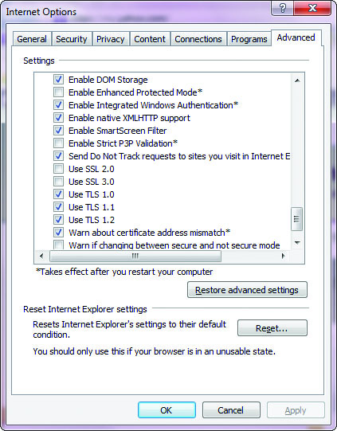
Figure 17.1 IE 11 security options
Notes:
Browsers from Mozilla (Firefox) and Microsoft (Internet Explorer 11) allow fairly extensive SSL/TLS setup options as shown in Figure 17.1

Slide 66
How SSL/TLS Works
An overview explains how SSL/TLS works.
The process begins with a client request for a secure connection and a server’s response.
For the client and server to communicate, both sides must agree on a commonly held protocol.
SSL v1, v2, v3, or TLS v1, v1.1, v1.2
Commonly available cryptographic algorithms include Diffie-Hellman and RSA.
The next step is to exchange certificates and keys as necessary to enable authentication.
Notes:
SSL/TLS uses a wide range of cryptographic protocols. SSL is no longer considered secure.
How SSL/TLS Works
To use these protocols effectively between a client and a server, an agreement must be reached on which protocol to use, which is done via the TLS handshake process.
The process begins with a client request for a secure connection and a server’s response.
For the client and server to communicate, both sides must agree on a commonly held protocol (SSL v1, v2, v3, or TLS v1).
Commonly available cryptographic algorithms include Diffie-Hellman and RSA.
The next step is to exchange certificates and keys as necessary to enable authentication.
The channel is protected by encryption against eavesdropping.
Each packet is encrypted using the symmetric key before transfer across the network, and then decrypted by the receiver.

Slide 67
How SSL/TLS Works (continued)
Once authentication is established, the channel is secured with symmetric key cryptographic methods and hashes.
Typically RC4 or 3DES for symmetric key and MD5 or SHA-1 for the hash functions.
The authenticity of the server and possibly the client has been established, and the channel is protected by encryption against eavesdropping.
Notes:
All of this work requires CPU time; hence, SSL/TLS connections require significantly more overhead than unprotected connections. Establishing connections is particularly time consuming, so even stateless web connections are held in a stateful fashion when secured via SSL/TLS, to avoid repeating the handshake process for each request. This makes some web server functionality more difficult, such as implementing web farms, and requires that either an SSL/TLS appliance be used before the web server to maintain state or the SSL/TLS state information be maintained in a directory-type service accessible by all of the web farm servers. Either method requires additional infrastructure and equipment. However, to enable secure e-commerce and other private data transactions over the Internet, this is a cost-effective method to establish a specific level of necessary security.

Slide 68
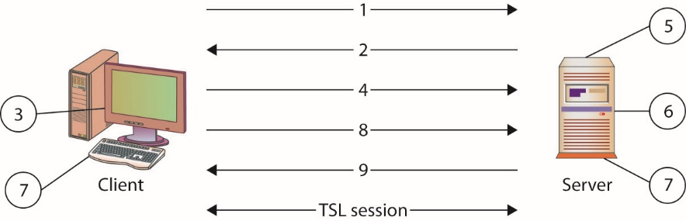
TLS handshake
Notes:
TLS Handshake
The following steps, depicted in the illustration above, establish a TLS secured channel (the SSL handshake is deprecated due to all versions of SSL being compromised):
The client sends to the server the client’s SSL version number, cipher settings, and session-specific data.
The server sends to the client the server’s SSL version number, cipher settings, session-specific data, and its own certificate. If the resource requested requires client authentication, the server requests the client’s certificate.
The client authenticates the server using the information it has received. If the server cannot be authenticated, the user is warned of the problem and informed that an encrypted and authenticated connection cannot be established.
The client encrypts a seed value with the server’s public key (from certificate—step 2) and sends it to the server. If the server requested client authentication, the client also sends the client certificate.
If the server requested client authentication, the server attempts to authenticate the client certificate. If the client certificate cannot be authenticated, the session ends.
The server uses its private key to decrypt the secret, and then performs a series of steps (which the client also performs) to generate a master secret. The required steps depend on the cryptographic method used for key exchange.
Both the client and the server use the master secret to generate the session key, which is a symmetric key used to encrypt and decrypt information exchanged during the SSL session.
The client sends a message informing the server that future messages from the client will be encrypted with the session key. It then sends a separate (encrypted) message indicating that the client portion of the handshake is finished.
The server sends a message informing the client that future messages from the server will be encrypted with the session key. It then sends a separate (encrypted) message indicating that the server portion of the handshake is finished.
The SSL handshake is now complete and the session can begin.

Slide 69
How SSL/TLS Works (continued)
Each packet is encrypted using the symmetric key before transfer across the network, and then decrypted by the receiver.
The use of certificates could present a lot of data and complication to a user.
Fortunately, browsers have incorporated much of this desired functionality into a seamless operation.

Slide 70
How SSL/TLS Works (continued)
Once you have decided always to accept code from XYZ Corporation, subsequent certificate checks are handled by the browser.
The ability to manipulate certificate settings is under the Options menus in both Internet Explorer and Mozilla Firefox.

Slide 71
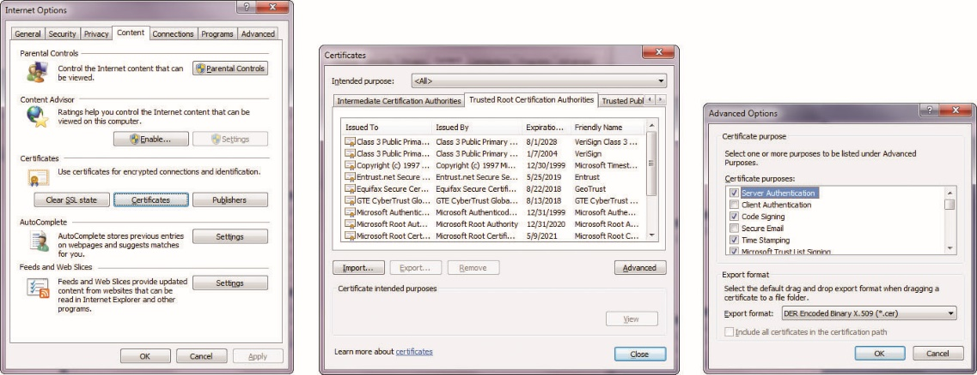
Figure 17.2 Internet Explorer certificate management options

Slide 72
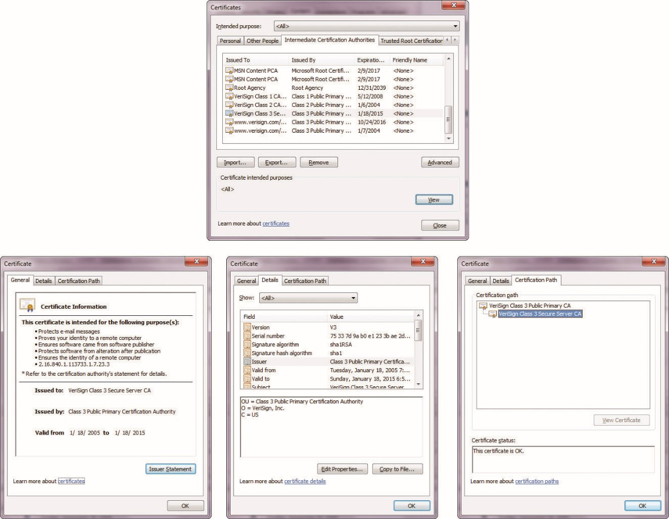
Figure 17.3 Internet Explorer certificate store

Slide 73
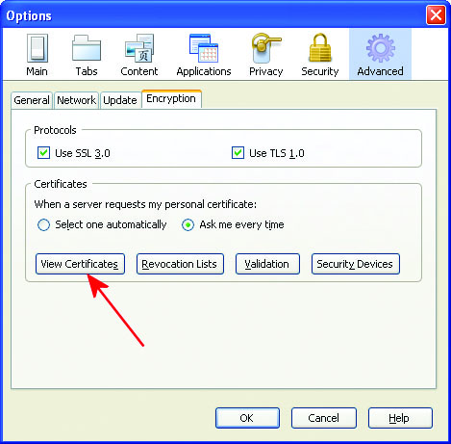
Figure 17.4 Firefox certificate options

Slide 74
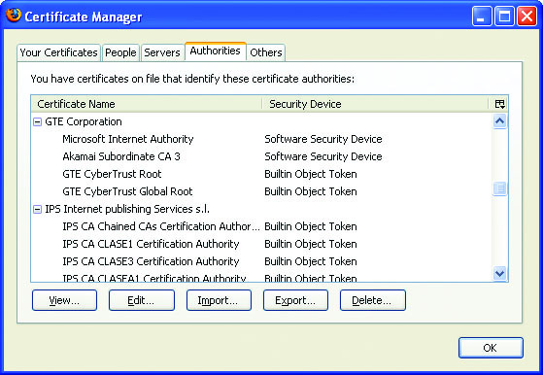
Figure 17.5 Firefox certificate store

Slide 75
How SSL/TLS Works (continued)
Once a communication is in the SSL/TLS channel, it is very difficult to defeat the SSL protocol
Before data enters the secured channel, however, defeat is possible.
A Trojan program that copies keystrokes and echoes them to another TCP/IP address in parallel with the intended communication can defeat SSL/TLS, for example, provided that the Trojan program copies the data prior to SSL/TLS encapsulation.
Notes:
This type of attack has occurred and has been used to steal passwords and other sensitive material from users, performing the theft as the user actually types in the data.

Slide 76
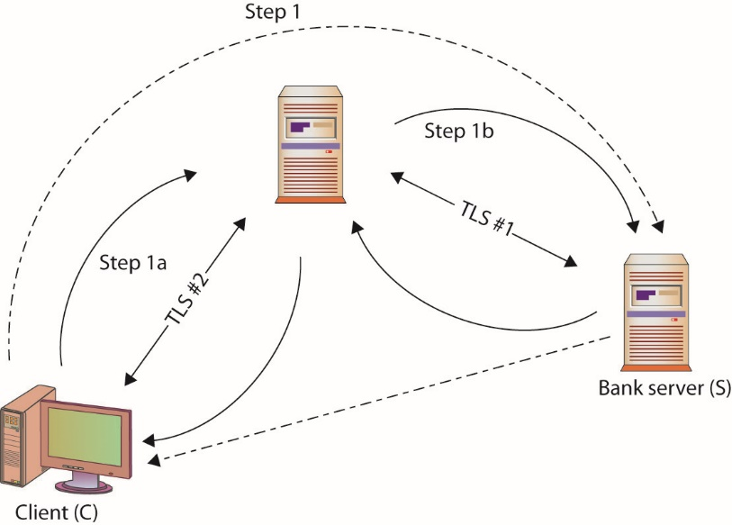
SSL/TLS man-in-the-middle attack
Notes:
SSL/TLS Proxy Attack
SSL/TLS-based security is not foolproof. It can be defeated, as in the case of a proxy-based attack. Examining the handshake, the following steps could occur, as shown in this illustration:
The client (C) initiates a TLS session with their bank server (S) through a proxy (P).
P acts by echoing the information sent to it by C (step 1a) to S (step 1b), imitating C to S, and establishing a secure channel between P and S (TLS #1).
P creates a second secure channel to C (TLS #2), using information received from S, pretending to be S.
The user assumes that the dotted lines occur—a secure channel to the bank directly—when the client actually has only a secure channel to the proxy. In fact, the proxy has the secure channel to the bank, and as far as the bank is concerned, the proxy is the client and using the client’s credentials. For a proxy that is not completely trusted, this could be a nightmare for the client.
The advent of high-assurance certificates prevents the proxy from imitating the bank, as it cannot give the correct set of credentials back to the client to complete the high-assurance handshake. Mutual authentication is also designed to prevent this, as the proxy cannot simultaneously imitate both sides of the handshake. Mutual authentication is rarely used, as there is the issue of maintaining client certificates that are trusted to a server—a challenge for broad-reach sites like financial institutions and e-commerce sites.

Slide 77
The Web (HTTP and HTTPS)
HTTP is used for the transfer of hyperlinked data over the Internet, from web servers to browsers.
When a secure connection is needed, SSL/TLS is used and appears in the address as https://.
If the protocol is https:, your connection is secure.
If the protocol is http:, then the connection is carried by plaintext for anyone to see.
Notes:
HTTP is used for the transfer of hyperlinked data over the Internet, from web servers to browsers. When a user types a URL such as http://www.example.com into a browser, the http:// portion indicates that the desired method of data transfer is HTTP. Although it was initially created just for HTML pages, today many protocols deliver content over this connection protocol. HTTP traffic takes place over TCP port 80 by default, and this port is typically left open on firewalls because of the extensive use of HTTP.
One of the primary drivers behind the development of SSL/TLS was the desire to hide the complexities of cryptography from end users. When using an SSL/TLS-enabled browser, this can be done simply by requesting a secure connection from a web server instead of a nonsecure connection. With respect to HTTP connections, this is as simple as using https:// in place of http://.
The entry of an SSL/TLS-based protocol will cause a browser to perform the necessary negotiations with the web server to establish the required level of security. Once these negotiations have been completed and the session is secured by a session key, a closed padlock icon is displayed in the lower right of the screen to indicate that the session is secure. If the protocol is https:, your connection is secure; if it is http:, then the connection is carried by plaintext for anyone to see.
EXAM TIP: HTTPS (HTTP over SSL) uses TCP Port 443. The unencrypted form is HyperText Transfer Protocol (HTTP), which uses TCP Port 80.

Slide 78
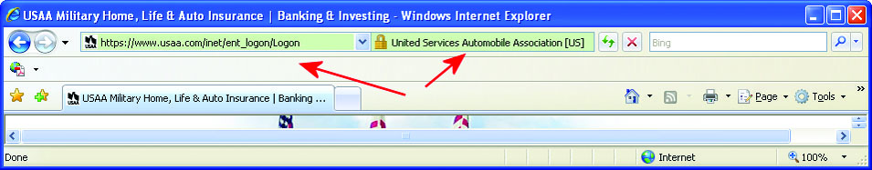
Figure 17.6 High-assurance notification in Internet Explorer
Notes:
Figure 17.6 shows a secure connection in Internet Explorer.
As of Internet Explorer 7, Microsoft places the padlock icon in an obvious position, next to the URL, instead of in the lower-right corner of the screen, where users could more easily miss it.

Slide 79
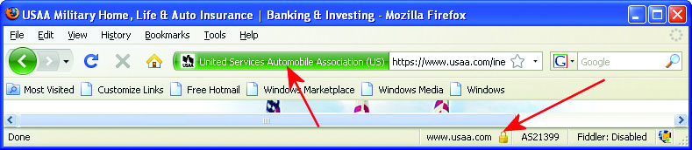
Figure 17.7 High-assurance notification in Firefox
Notes:
Figure 17.7 shows a secure connection in Firefox.

Slide 80
The Web (HTTP and HTTPS) (continued)
To combat a variety of attacks, in 2006 the SSL/TLS landscape changed with the advent of extended validation certificates and high security browsers.
These changes provide visual cues to the user when high assurance certificates are being used as part of a secure SSL/TLS connection.
The objective of enabling cryptographic methods in this fashion is to make it easy for end users to use these protocols.
SSL/TLS is designed to be protocol agnostic.
Notes:
To combat a variety of attacks, in 2006 the SSL/TLS landscape changed with the advent of extended validation certificates and high security browsers. These changes provide visual cues to the user when high assurance certificates are being used as part of a secure SSL/TLS connection. These improvements were in response to phishing sites and online fraud, and although they require additional costs and registration on the part of the vendors, this is a modest up-front cost to help reduce fraud and provide confidence to customers.
The objective of enabling cryptographic methods in this fashion is to make it easy for end users to use these protocols. SSL/TLS is designed to be protocol agnostic. Although designed to run on top of TCP/IP, it can operate on top of other, lower-level protocols, such as X.25. SSL/TLS requires a reliable lower-level protocol, so it is not designed and cannot properly function on top of a nonreliable protocol such as the User Datagram Protocol (UDP). Even with this limitation, SSL/TLS has been used to secure many common TCP/IP-based services.

Slide 81
HTTPS Everywhere
With a variety of encryption technologies available, managing the resources for HTTPS connections is much easier, and a case has been made by many in security that all web connections should be HTTPS.
This has resulted in the HTTPS Everywhere movement.
HTTPS Everywhere would go a long way for privacy, because it would prevent data snooping.
HTTPS Everywhere would prevent many man-in-the-middle attacks, such as SSL stripping.
Notes:
When websites were first deployed, providing HTTPS was a resource cost issue, because it took processor cycles to encrypt all the connections. Today, with a variety of encryption technologies available, managing the resources for HTTPS connections is much easier, and a case has been made by many in security that all web connections should be HTTPS. This has resulted in the HTTPS Everywhere movement (https://www.eff.org/https-everywhere/), spearheaded by the Electronic Frontier Foundation (EFF).
If web sites everywhere would turn off HTTP in favor of using only HTTPS (with TLS in light of SSL vulnerabilities), this would not solve all the security problems, but it would raise the bar substantially for many attacks. HTTPS Everywhere would go a long way for privacy, because it would prevent data snooping. It would also prevent many man-in-the-middle attacks, such as SSL stripping.

Slide 82
HTTP Strict Transport Security
HTTP Strict Transport Security (HSTS) is an IETF standard and a mechanism to enforce rules to prevent browsers from downgrading security when accessing a site.
HSTS was created in response to a series of attack profiles.
The SSL stripping attack works on both SSL and TLS by transparently converting the secure HTTPS connection into a plain HTTP connection, removing the transport layer encryption protections.
Notes:
HTTP Strict Transport Security (HSTS) is an IETF standard and a mechanism to enforce rules to prevent browsers from downgrading security when accessing a site. The policy states that when a web server provides an HTTP response header field named “Strict-Transport-Security,” then the user agent shall comply by not issuing insecure requests. The header field has a time period associated with it, set in the header, during which the policy is in effect.
The SSL stripping attack works on both SSL and TLS by transparently converting the secure HTTPS connection into a plain HTTP connection, removing the transport layer encryption protections. Although an observant user might notice the drop in security, by then the damage may have been done, and this relies upon users knowing whether a page should be secure or not. No warnings are presented to the user during the downgrade process, which makes the attack fairly subtle to all but the most vigilant. Marlinspike’s sslstrip tool fully automates the attack and is available on the Web.

Slide 83
Directory Services (DAP and LDAP)
A directory is designed and optimized for reading data, offering very fast search and retrieval operations.
To enable interoperability, the X.500 standard was created as a standard for directory services.
The primary method for accessing an X.500 directory is through the Directory Access Protocol (DAP).
Lightweight Directory Access Protocol (LDAP) contains the most commonly used functionality.
Notes:
A directory is a data storage mechanism similar to a database, but it has several distinct differences designed to provide efficient data retrieval services compared to standard database mechanisms. A directory is designed and optimized for reading data, offering very fast search and retrieval operations. The types of information stored in a directory tend to be descriptive attribute data. A directory offers a static view of data that can be changed without a complex update transaction. The data is hierarchically described in a treelike structure, and a network interface for reading is typical.
To enable interoperability, the X.500 standard was created as a standard for directory services. The primary method for accessing an X.500 directory is through the Directory Access Protocol (DAP), a heavyweight protocol that is difficult to implement completely, especially on PCs and more constrained platforms.
This led to the Lightweight Directory Access Protocol (LDAP), which contains the most commonly used functionality. LDAP can interface with X.500 services, and, most importantly, LDAP can be used over TCP with significantly less computing resources than a full X.500 implementation. LDAP offers all of the functionality most directories need and is easier and more economical to implement; hence LDAP has become the Internet standard for directory services.

Slide 84
Directory Services (DAP and LDAP) (continued)
SSL/TLS LDAP
SSL/TLS provides several important functions to LDAP services:
Establishes the identity of a data source through the use of certificates.
Provides for the integrity and confidentiality of the data being presented from an LDAP source.
Interoperability is a function of correct setup.
Once an LDAP server is set up to function over an SSL/TLS connection, it operates as it always has.
Notes:
SSL/TLS provides several important functions to LDAP services. It can establish the identity of a data source through the use of certificates, and it can also provide for the integrity and confidentiality of the data being presented from an LDAP source.
As LDAP and SSL/TLS are two separate independent protocols, interoperability is more a function of correct setup than anything else. To achieve LDAP over SSL/TLS, the typical setup is to establish an SSL/TLS connection and then open an LDAP connection over the protected channel. To do this requires that both the client and the server be enabled for SSL/TLS. In the case of the client, most browsers are already enabled. In the case of an LDAP server, this specific function must be enabled by a system administrator. As this setup initially is complicated, it’s definitely a task for a competent system administrator.
Once an LDAP server is set up to function over an SSL/TLS connection, it operates as it always has. The LDAP server responds to specific queries with the data returned from a node in the search. The SSL/TLS functionality is transparent to the data flow from the user’s perspective. From the outside, SSL/TLS prevents observation of the data request and response, ensuring confidentiality.

Slide 85
File Transfer (FTP and SFTP)
File Transfer Protocol (FTP) is an application-level protocol that operates over a wide range of lower-level protocols.
FTP is embedded in most operating systems and provides a method of transferring files from a sender to a receiver.
FTP clients initiate transactions and FTP respond to transaction requests.
Clients for FTP on a PC can range from an application program, to the command-line FTP program in Windows/DOS to most browsers.
Notes:
File Transfer Protocol (FTP) is an application-level protocol that operates over a wide range of lower-level protocols. FTP is embedded in most operating systems and provides a method of transferring files from a sender to a receiver. Most FTP implementations are designed to operate both ways, sending and receiving, and can enable remote file operations over a TCP/IP connection. FTP clients are used to initiate transactions, and FTP servers are used to respond to transaction requests. The actual request can be either to upload (send data from client to server) or to download (send data from server to client).
Clients for FTP on a PC can range from an application program, to the command-line FTP program in Windows/DOS, to most browsers. To open an FTP data store in a browser, you can enter ftp://url in the browser’s address field to indicate that you want to see the data associated with the URL via an FTP session—the browser handles the details.

Slide 86
File Transfer (FTP and SFTP) (continued)
Blind FTP (anonymous FTP)
In FTP, a standard account called anonymous exists.
It allows unlimited public access to the files.
It is commonly used for unlimited distribution.
On a server, access permissions can be established to allow only downloading or only uploading or both.
FTP servers present a security risk so it is typically not permitted on workstations, and disabled on servers without need for this functionality.
Notes:
To access resources on a computer, an account must be used to allow the operating system–level authorization function to work. In the case of an FTP server, you may not wish to control who gets the information, so a standard account called anonymous exists. This allows unlimited public access to the files and is commonly used when you want to have unlimited distribution.
On a server, access permissions can be established to allow only downloading or only uploading or both, depending on the system’s function. As FTP servers can present a security risk, they are typically not permitted on workstations and are disabled on servers without need for this functionality.

Slide 87
File Transfer (FTP and SFTP) (continued)
SFTP
FTP operates in a plaintext mode.
Secure FTP (SFTP) combines both the Secure Shell (SSH) protocol and FTP to allow confidential transfer.
SFTP operates as an application program that encodes both the commands and the data being passed and requires SFTP to be on both the client and the server.
SFTP is not interoperable with standard FTP.
The server must be enabled with the SFTP program, and then clients can access the server, provided they have the correct credentials.
Notes:
FTP operates in a plaintext mode, so an eavesdropper can observe the data being passed. If confidential transfer is required, Secure FTP (SFTP) combines both the Secure Shell (SSH) protocol and FTP to accomplish this task.
SFTP operates as an application program that encodes both the commands and the data being passed and requires SFTP to be on both the client and the server. SFTP is not interoperable with standard FTP—the encrypted commands cannot be read by the standard FTP server program.
To establish SFTP data transfers, the server must be enabled with the SFTP program, and then clients can access the server, provided they have the correct credentials. One of the first SFTP operations is the same as that of FTP: an identification function that uses a username and an authorization function that uses a password. There is no anonymous SFTP account by definition, so access is established and controlled from the server using standard access control lists (ACLs), IDs, and passwords.

Slide 88
Vulnerabilities
The use of protocols such as TLS can result in complacency.
Using TLS and other encryption methods will not guard against your credit card information being “lost” by a company with which you do business.
The key to understanding what is protected and where it is protected is to understand what these protocols can and cannot do.
Notes:
Modern encryption technology can provide significant levels of privacy, up to military-grade secrecy. The use of protocols such as TLS provides a convenient method for end users to use cryptography without having to understand how it works. This can result in complacency—the impression that once TLS is enabled, the user is safe, but this is not necessarily the case. If a Trojan program is recording keystrokes and sending the information to another unauthorized user, for example, TLS cannot prevent the security breach. If the user is connecting to an untrustworthy site, the mere fact that the connection is secure does not prevent the other site from running a scam.
Using TLS and other encryption methods will not guard against your credit card information being “lost” by a company with which you do business, as in the Egghead.com credit card hack of 2000. In December 2000, Egghead.com’s credit card database was hacked, and as many as 3.7 million credit card numbers were exposed. This resulted eventually in the loss of the firm, which is now known as NewEgg. The year 2014 was a year filled with data breaches, losses of customer information—including credit card numbers—from many high-profile merchants such as Target. In these cases, the security failure was internal to the data storage in the company, not during transfer to the firm. So even with secure web controls, data can be lost after being stored in a company database.
The key to understanding what is protected and where it is protected is to understand what these protocols can and cannot do. The TLS suite can protect data in transit, but not on either end in storage. It can authenticate users and servers, provided that the certificate mechanisms are established and used by both parties. Properly set up and used, TLS can provide a very secure method of authentication, followed by confidentiality in data transfers and data integrity checking. But again, all of this occurs during transit, and the protection ends once the data is stored.

Slide 89
Code-Based Vulnerabilities
The idea of extending browser functions through plug-ins became a standard.
The opportunity exists for these applications or plug-ins to include malicious code that performs actions not desired by the end user.
Web browser malicious code is a major tool for computer crackers to use to obtain unauthorized computer access.
Whether delivered by HTML based e-mail, by getting a user to visit a web site, or even delivery via an ad server, the result is the same: malware performs malicious tasks in the browser environment.

Slide 90
Buffer Overflows
One of the most common exploits used to hack into software is the buffer overflow.
The buffer overflow vulnerability is a result of poor coding practices on the part of software programmers.
This occurs when an application can accept more input than it has assigned storage space and the input data overwrites other program areas.
Notes:
The exploit concept is simple: An attacker develops an executable program that performs some action on the target machine and appends this code to a legitimate response to a program on the target machine. When the target machine reads through the too-long response, a buffer-overflow condition causes the original program to fail. The extra malicious code fragment is now in the machine’s memory, awaiting execution. If the attacker executed it correctly, the program will skip into the attacker’s code running it instead of crashing.

Slide 91
Java
Java is a computer language invented by Sun Microsystems as an alternative to Microsoft’s development languages.
Designed to be platform-independent and based on C
Offered a low learning curve and a way of implementing programs across an enterprise
Found itself to be a leader in object-oriented programming languages
Operates through an interpreter called a Java Virtual Machine (JVM) on each platform
Notes:
Java is a computer language invented by Sun Microsystems as an alternative to Microsoft’s development languages. Designed to be platform-independent and based on C, Java offered a low learning curve and a way of implementing programs across an enterprise, independent of platform. Although platform independence never fully materialized, and the pace of Java language development was slowed by Sun, Java has found itself to be a leader in object-oriented programming languages.

Slide 92
Java (continued)
Reliance on an interpretive step has led to performance issues.
Security is not a built-in function but an afterthought implemented independently of the language core.
Java has safety features, but safety is not security.
A malicious Java program can cause significant damage.
Sun provides different levels of security.
Do not to run Java programs at all.
Restrict Java program functionality when the program is not run directly from the system’s hard drive.
Notes:
Java was initially designed to be used in trusted environments, and when it moved to the Internet for general use, safety became one of its much-hyped benefits. Java has many safety features, such as type checking and garbage collection, that actually improve a program’s ability to run safely on a machine and not cause operating system–level failures. This isolates the user from many common forms of operating system faults that can end in the “blue screen of death” in a Windows environment, where the operating system crashes and forces a reboot of the system. Safety is not security, however, and although safe, a malicious Java program can still cause significant damage to a system.
The primary mode of a computer program is to interact with the operating system and perform functional tasks for a user, such as getting and displaying data, manipulating data, storing data, and so on. Although these functions can seem benign, when enabled across the Web they can have some unintended consequences. The ability to read data from a hard drive and display it on the screen is essential for many programs, but when the program is downloaded and run from the Internet and the data is, without the knowledge of the user, sent across the Internet to an unauthorized user, this enables a program to spy on a user and steal data. Writing data to the hard drive can also cause deletions if the program doesn’t write the data where the user expects.
Most browsers adopted the second security policy, restricting Java functionality on a client unless the program was loaded directly from the client’s hard drive. Although this solved many problems initially, it also severely limited functionality. Today, browsers allow much more specific granularity on security for Java, based on security zones and user settings.

Slide 93
JavaScript
JavaScript is a scripting language developed by Netscape and designed to be operated within a browser instance.
The primary purpose is to enable features such as validation of forms.
Enterprising programmers found many other uses for JavaScript, such as manipulating the browser history files, now prohibited by design.
JavaScript runs within the browser and the code is executed by the browser itself.
This has led to compatibility problems.

Slide 94
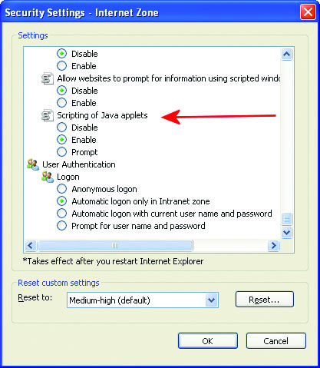
Figure 17.8 Java configuration settings in Internet Explorer
Notes:
Security settings in Internet Explorer are done by a series of zones, allowing differing levels of control over .NET functionality, ActiveX functionality, and Java functionality (see Figure 17.8).
Unfortunately, these settings can be changed by a Trojan program, altering the browser (without alerting the user) and lowering the security settings.

Slide 95
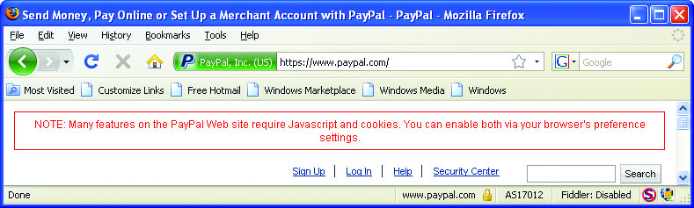
Figure 17.9 Security setting functionality issues
Notes:
Security settings can be changed by a Trojan program, altering the browser (without alerting the user) and lowering the security settings. In Firefox, using the NoScript plug-in is a solution to this, but the reduced functionality leads to other issues, as shown in Figure 17.9, and requires more diligent user intervention.

Slide 96
JavaScript (continued)
JavaScript's lack of a comprehensive security model left some security holes.
A form could submit itself via e-mail to an undisclosed recipient, either eavesdropping, spamming, or causing other problems.
Most browsers do not have a mechanism to halt a running script short of aborting the browser instance.
This may not be possible if the browser has stopped responding to commands.
Notes:
Although JavaScript was designed not to be able to access files or network resources directly, except through the browser functions, it has not proven to be as secure as desired. This fault traces back to a similar fault in the Java language, where security was added on, without the benefit of a comprehensive security model.
So, although designers put thought and common sense into the design of JavaScript, the lack of a comprehensive security model left some security holes. For instance, a form could submit itself via e-mail to an undisclosed recipient, either eavesdropping, spamming, or causing other problems—imagine your machine sending death threat e-mails to high-level government officials from a rogue JavaScript implementation.
Further, most browsers do not have a mechanism to halt a running script, short of aborting the browser instance, and even this may not be possible if the browser has stopped responding to commands. Malicious JavaScripts can do many things, including opening two new windows every time you close one, each with the code to open two more. There is no way out of this one, short of killing the browser process from the operating system.

Slide 97
JavaScript (continued)
Malicious JavaScripts can do many things.
Opening two new windows every time you close one, each with the code to open two more.
There is no way out of this one, short of killing the browser process from the operating system.
JavaScripts can also trick users into thinking they are communicating with one entity when in fact they are communicating with another.
Notes:
JavaScripts can also trick users into thinking they are communicating with one entity when in fact they are communicating with another. For example, a window may open asking whether you want to download and execute the new update from “http://www.microsoft.com…./update.exe,” and what is covered by the ellipsis (…) is actually “www.microsoft.com. attacker.org/”—the user assumes this is a Microsoft address that is cut short by space restrictions on the display.
As a browser scripting language, JavaScript is here to stay. Its widespread popularity for developing applets such as animated clocks, mortgage calculators, and simple games will overcome its buggy nature and poor level of security.

Slide 98
ActiveX
ActiveX is the name given to a broad collection of application programming interfaces (APIs), protocols, and programs developed by Microsoft to download and execute code automatically over an Internet-based channel.
The code is bundled together into an ActiveX control with an .ocx extension.
ActiveX is a tool for the Windows environment and can be extremely powerful.
Its range of abilities give ActiveX a lot of power, but this power can be abused.
Notes:
Exam Tip: ActiveX technology can be used to create complex application logic that is then embedded into other container objects such as a web browser. ActiveX components have very significant capabilities and thus malicious ActiveX objects can be very dangerous. Authenticode is a means of signing an ActiveX control so that a user can judge trust based on the control’s creator.

Slide 99
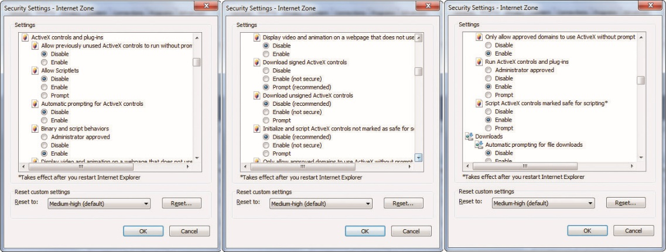
Figure 17.10 ActiveX security settings in Internet Explorer
Notes:
Internet Explorer has several options to control the execution of ActiveX controls, as illustrated in the picture above.

Slide 100
ActiveX (continued)
To enable security and consumer confidence in downloaded programs such as ActiveX controls, Microsoft developed Authenticode.
A system that uses digital signatures and allows Windows users to determine who produced a specific piece of code and whether or not the code has been altered.
Safety and security are different things, and Authenticode promotes neither in reality.

Slide 101
ActiveX (continued)
Authenticode does not identify whether a piece of code will cause damage to a system, nor does it regulate how code is used.
A perfectly safe ActiveX control under one set of circumstances may be malicious if used improperly.
Critics argue that code signing is not a panacea for security issues and that marketing it as doing more than it really does is irresponsible.
Notes:
Authenticode provides limited accountability at the time of download and provides reasonable assurance that the code has not been changed since the time of signing. Authenticode does not identify whether a piece of code will cause damage to a system, nor does it regulate how code is used, so a perfectly safe ActiveX control under one set of circumstances may be malicious if used improperly. As with a notary’s signature, recourse is very limited—if code is signed by a terrorist organization and the code ruins your machine, all Authenticode did was make it seem legitimate. It is still incumbent upon the users to know from whom they are getting code and to determine whether or not they trust that organization.
Critics of Authenticode and other code-signing techniques are not against code signing, for this is a universally recognized good thing. What the critics argue is that code signing is not a panacea for security issues and that marketing it as doing more than it really does is irresponsible. Understanding the nuances of security is important in today’s highly technical world, and leaving the explanations to marketing departments is not the ideal solution.

Slide 102
Securing the Browser
Added features means weaker security.
No browser is 100 percent safe.
Currently Firefox coupled with the NoScript plug-in provides good protection.
Firefox will not execute ActiveX, so that threat vector is removed.
The NoScript plug-in allows the user to determine from which domains to trust scripts.
Notes:
A great deal of debate concerns the relative security issue of browser extensions versus the rich user interaction that they provide. There is no doubt that the richness of the environment offered by ActiveX adds to the user experience.
But as is the case in most coding situations, added features means weaker security, all other things being constant. If nothing else, a development team must spend some portion of its time on secure development practices, time that some developers and marketers would prefer to spend on new features.
Although no browser is 100 percent safe, the use of Firefox coupled with the NoScript plug-in comes the closest to fitting the bill. Firefox will not execute ActiveX, so that threat vector is removed.
The NoScript plug-in allows the user to determine from which domains to trust scripts. The use of NoScript puts the onus back on the user as to which domain scripts they choose to trust, and although it’s not perfect from a security perspective, this at least allows a measure of control over what code you want to run on your machine.

Slide 103
CGI
The Common Gateway Interface (CGI) was the original method for having a web server execute a program outside the web server process, yet on the same server.
The programs can be written in a number of languages.
The scripted programs embrace the full functionality of a server.
Poorly written scripts can cause unintended consequences at runtime and their defects are not always obvious.
CGI is an outdated and mostly retired technology.
Notes:
The Common Gateway Interface (CGI) was the original method for having a web server execute a program outside the web server process, yet on the same server. CGI offered many advantages to web-based programs. The programs can be written in a number of languages, although Perl is a favorite. These scripted programs embrace the full functionality of a server, allowing access to databases, UNIX commands, other programs, and so on. This provides a wide range of functionality to the web environment. With this unrestrained capability, however, come security issues. Poorly written scripts can cause unintended consequences at runtime. The problem with poorly written scripts is that their defects are not always obvious. Sometimes scripts appear to be fine, but unexpected user inputs can have unintended consequences.
CGI is an outdated, and for the most part retired, technology. It has been replaced by newer scripting methods.

Slide 104
Server-Side Scripts
CGI has been replaced in many web sites through newer server-side scripting technologies such as Java, Active Server Pages (ASP), ASP.NET, and PHP.
These technologies operate in much the same fashion as CGI: they allow programs to be run outside the web server and to return data to the web server to be served to end users via a web page.
The term server-side script is actually a misnomer, as these are actually executable programs that are either interpreted or run in virtual machines.
These technologies have stronger security models than CGI.
Notes:
Each of these newer technologies has advantages and disadvantages, but all of them have stronger security models than CGI. With these security models come reduced functionality and, as each is based on a different language, a steeper learning curve. Still, the need for adherence to programming fundamentals exists in these technologies—code must be well designed and well written to avoid the same vulnerabilities that exist in all forms of code. Buffer overflows are still an issue. Changing languages or technologies does not eliminate the basic security problems associated with incorporating open-ended user input into code. Understanding and qualifying user responses before blindly using them programmatically is essential to the security of a system.

Slide 105
Server-Side Scripts (continued)
Each technology is based on a different language.
Results in a steeper learning curve
Must adhere to programming fundamentals.
Use well designed and well written code as buffer overflows are still an issue.
Basic security problems associated with incorporating open-ended user input into code still exist.
Understanding and qualifying user responses before blindly using them programmatically is essential to the security of a system.
Notes:
Each of these newer technologies has advantages and disadvantages, but all of them have stronger security models than CGI. With these security models come reduced functionality and, as each is based on a different language, a steeper learning curve. Still, the need for adherence to programming fundamentals exists in these technologies—code must be well designed and well written to avoid the same vulnerabilities that exist in all forms of code. Buffer overflows are still an issue. Changing languages or technologies does not eliminate the basic security problems associated with incorporating open-ended user input into code. Understanding and qualifying user responses before blindly using them programmatically is essential to the security of a system.

Slide 106
Cookies
Cookies are small chunks of ASCII text passed within an HTTP stream to store data temporarily in a web browser instance.
A cookie is a series of name-value pairs that is stored in memory during a browser instance.
Expires, Domain, Path, and Secure
Because cookies are stored on a user’s machine in a form that will allow simple manipulation, they must always be considered suspect and are not suitable for use as a security mechanism.
Notes:
A cookie is actually a series of name-value pairs that is stored in memory during a browser instance. The specification for cookies established several specific name-value pairs for defined purposes. Additional name-value pairs may be defined at will by a developer. The specified set of name-value pairs includes the following: ■ Expires – This field specifies when the cookie expires. If no value exists, the cookie is good only during the current browser session and will not be persisted to the user’s hard drive. Should a value be given, the cookie will be written to the user’s machine and persisted until this datetime value occurs. ■ Domain – Specifies the domain where the cookie is used. Cookies were designed as memory-resident objects, but as the user or data can cause a browser to move between domains—say, from comedy.net to jokes.org—some mechanism needs to tell the browser which cookies belong to which domains.
■ Path – This name-value pair further resolves the applicability of the cookie into a specific path within a domain. If path = /directory, the cookie will be sent only for requests within /directory on the given domain. This allows a level of granular control over the information being passed between the browser and server, and it limits unnecessary data exchanges.
■ Secure – The presence of the keyword [secure] in a cookie indicates that it is to be used only when connected in an SSL/TLS session. This does not indicate any other form of security, as cookies are stored in plaintext on the client machine. Cookie management on a browser is normally an invisible process, but most browsers have methods for users to examine and manipulate cookies on the client side.
So what good are cookies? Disable cookies in your browser and go to some common sites that you visit, and you’ll quickly learn the usefulness of cookies. Cookies store a variety of information, from customer IDs to data about previous visits. Because cookies are stored on a user’s machine in a form that will allow simple manipulation, they must always be considered suspect and are not suitable for use as a security mechanism. They can, however, allow the browser to provide crucial pieces of information to a web server. Advertisers can use them to control which ads you are pages, enabling functionality at the user’s desired levels. Cookies can also remember your ZIP code for a weather site, your ID for a stock tracker site, the items in your shopping cart—these are all typical cookie uses. In the final analysis, cookies are a part of the daily web experience, here to stay and useful if not used improperly (such as to store security data and to provide ID and authentication).

Slide 107
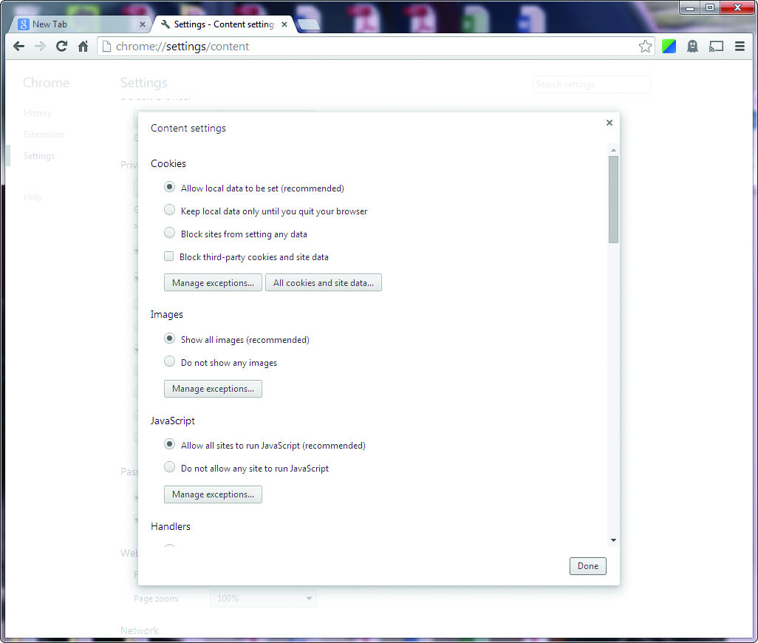
Figure 17.11 Chrome cookie management
Notes:
Chrome users can examine, delete, and block individual cookies through the interface shown in Figure 17.11.

Slide 108
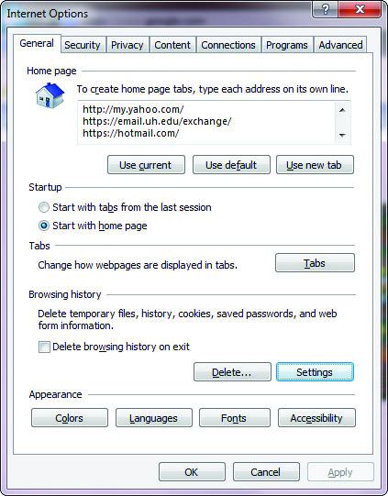
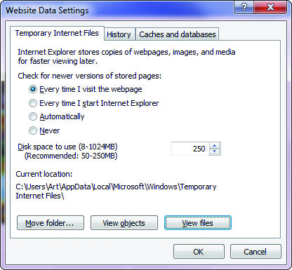
Figure 17.12 Internet Explorer cookie management
Notes:
Internet Explorer has a similar interface, with just a Delete option in the browser under Browsing History (see Figure 17.12).

Slide 109
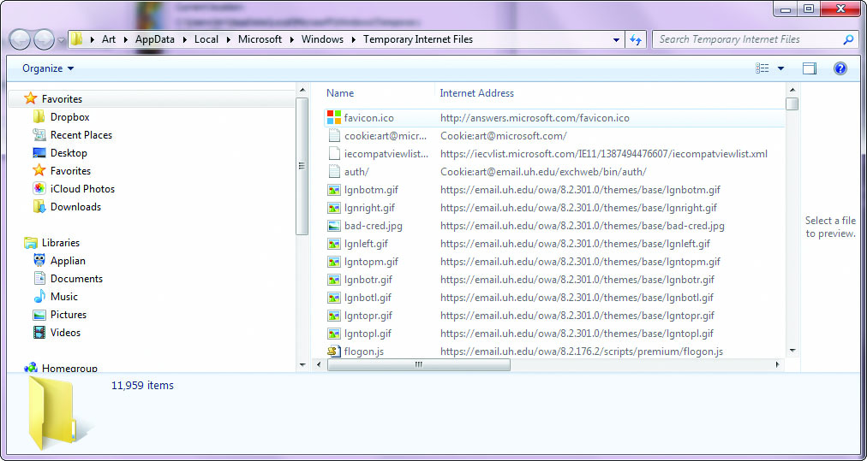
Figure 17.13 Internet Explorer cookie store
Notes:
Additional cookie manipulation can be done through the file processing system, because cookies are stored as individual files, as shown in Figure 17.13. This combination allows easier bulk manipulation, which is a useful option, as cookies can become quite numerous in short order.

Slide 110
Cookies (continued)
If the user disables cookies in a browser, this type of information will not be available for the web server to use.
IETF RFC 2109 describes the HTTP state-management system (cookies) and specifies several specific cookie functions to be enabled in browsers, specifically:
The ability to turn on and off cookie usage
An indicator as to whether cookies are in use
A means of specifying cookie domain values and lifetimes
Notes:
Disabling Cookies
If the user disables cookies in a browser, this type of information will not be available for the web server to use. IETF RFC 2109 describes the HTTP state-management system (cookies) and specifies several specific cookie functions to be enabled in browsers, specifically:
■ The ability to turn on and off cookie usage
■ An indicator as to whether cookies are in use
■ A means of specifying cookie domain values and lifetimes
Several of these functions have already been discussed, but to surf cookie-free requires more than a simple step. Telling a browser to stop accepting cookies is a setup option available through an Options menu, but this has no effect on cookies already received and stored on the system. To prevent the browser from sending cookies already received, the user must delete the cookies from the system. This bulk operation is easily performed, and then the browser can run cookie-free. Several third-party tools enable even a finer granularity of cookie control.

Slide 111
Browser Plug-ins
Plug-ins are small application programs that increase a browser’s ability to handle new data types and add new functionality.
Until recently, plug-ins have had a remarkable safety record.
As Flash-based content has grown more popular, crackers have examined the Flash plug-ins and software, determined vulnerabilities, and developed exploit code to use against the Flash protocol.
The death of Flash is on the horizon.
Notes:
Sometimes these plugins are in the form of ActiveX components, which is the form Microsoft chose for its Office plug-in, which enables a browser to manipulate various Office files, such as pivot tables from Excel, over the Web. Adobe has developed Acrobat Reader, a plug-in that enables a browser to read and display Portable Document Format (PDF) files directly in a browser. PDF files offer platform independence for printed documents and are usable across a wide array of platforms—they are a compact way to provide printed information.
The combination of a development environment for developers and plug-in–enabled browsers that can display the content has caused these technologies to see widespread use. The result is a tremendous increase in visual richness in web communications, and this, in turn, has made the Web more popular and has increased usage in various demographic segments.
Until recently, these plug-ins have had a remarkable safety record. As Flash-based content has grown more popular, crackers have examined the Flash plug-ins and software, determined vulnerabilities, and developed exploit code to use against the Flash protocol. Adobe has patched the issue, but as Apple has decided not to
use Flash on its iPhones or iPads, the death of Flash is on the horizon.

Slide 112
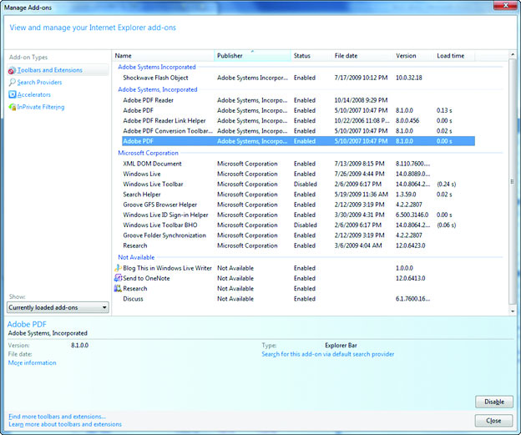
Figure 17.14 Add-ons for Internet Explorer
Notes:
Figure 17.14 illustrates the various plug-ins and browser helper objects enabled in Internet Explorer.

Slide 113
Malicious Add-ons
Add-ons are pieces of code that are distributed to allow additional functionality to be added to an existing program.
A browser helper object (BHO) has unrestricted access to the Internet Explorer event model; it can capture keystrokes.
Other programs can have addons that utilize the permissions given the master program.
Understand the level of interaction risk they pose.
Unless signed by a trusted authority using Authenticode, ActiveX content should not be allowed in browsers, as the nature of the code changes can present significant risk.
Notes:
Add-ons are pieces of code that are distributed to allow additional functionality to be added to an existing program. An example of these are browser helper objects (BHOs), which provide a means of creating a plugin module that is loaded with Internet Explorer and provide a means of adding capability to the browser. The functionality can be significant, as in the case of the Adobe Acrobat BHO that allows PDFs to be rendered in the browser. A BHO has unrestricted access to the Internet Explorer event model and can do things such as capture keystrokes.
Other programs can have addons that utilize the permissions given the master program. You should only use add-ons from trusted sources, and you need to understand the level of interaction risk they pose. ActiveX is a technology implemented by Microsoft to enhance web-enabled systems through significant additions to user controls. For example, unless signed by a trusted authority using Authenticode, ActiveX content should not be allowed in browsers, as the nature of the code changes can present significant risk.

Slide 114
Signed Applets
Code signing was an attempt to bring the security of shrink-wrapped software to software downloaded from the Internet.
A signed applet can be hijacked as easily as a graphic or any other file.
Two ways an attacker could hijack a signed control are by inline access or by copying the file in its entirety and republishing it.
Inlining is using an embedded control from another site with or without the other site’s permission.
Notes:
Code signing was an attempt to bring the security of shrink-wrapped software to software downloaded from the Internet. Code signing works by adding a digital signature and a digital certificate to a program file to demonstrate file integrity and authenticity. The certificate identifies the author, and the digital signature contains a hash value that covers code, certificate, and signature to prove integrity, and this establishes the integrity of the code and publisher via a standard browser certificate check. The purpose of a company signing the code is to state that it considers the code it created to be safe, and it is stating that the code will not do any harm to the system (to the company’s knowledge). The digital signature also tells the user that the stated company is, indeed, the creator of the code.
A signed applet can be hijacked as easily as a graphic or any other file. The two ways an attacker could hijack a signed control are by inline access or by copying the file in its entirety and republishing it.
Inlining is using an embedded control from another site with or without the other site’s permission.
Republishing a signed control is done much like stealing a GIF or JPEG image—a copy of the file is maintained on the unauthorized site and served from there instead of from the original location.

Slide 115
Signed Applets (continued)
The primary security concern comes from how the control is used.
A cracker may be able to use a control in an unintended fashion, resulting in file loss or buffer overflow—conditions that weaken a system and can allow exploitation of other vulnerabilities.
These are concerns not addressed simply by signing a control or applet.
Notes:
If a signed control cannot be modified, why be concerned with these thefts, apart from the issue of intellectual property? The primary security concern comes from how the control is used. A cracker may be able to use a control in an unintended fashion, resulting in file loss or buffer overflow—conditions that weaken a system and can allow exploitation of other vulnerabilities.
A common programming activity is cleaning up installation files from a computer’s hard drive after successfully installing a software package. If a signed control is used for this task and permission has already been granted, then improperly using the control could result in the wrong set of files being deleted. The control will still function as designed, but the issue becomes who it is used by and how. These are concerns not addressed simply by signing a control or applet.

Slide 116
Application-Based Weaknesses
The application software written to run on servers and serve up the content for users is also a target.
Attacking web-based applications has proven to be a lucrative venture for several reasons.
The target is a rich environment.
Building these custom applications to high levels of security is a difficult if not impossible feat.
The same programmatic errors that plague operating systems can cause havoc with web-based systems.
Notes:
Web browsers are not the only aspect of software being abused by crackers. The application software written to run on servers and serve up the content for users is also a target. Web application security is a fairly hot topic in security, as it has become a prime target for professional crackers. Criminal hackers typically are after some form of financial reward, whether from stolen data, stolen identity, or some form of extortion.
Attacking web-based applications has proven to be a lucrative venture for several reasons. First, the target is a rich environment, as company after company has developed a customer-facing web presence, often including custom-coded functionality that permits customer access to back-end systems for legitimate business purposes. Second, building these custom applications to high levels of security is a difficult if not impossible feat, especially given the corporate pressure on delivery time and cost.
The same programmatic errors that plague operating systems, such as buffer overflows, can cause havoc with web-based systems. But web-based systems have a new history of rich customer interactions, including the collection of information from the customer and dynamically using customer-supplied information to modify the user experience. This makes the customer a part of the application, and when proper controls are not in place, errors such as the MySpace-based Samy worm can occur. Different types of errors are commonly observed in the deployment of web applications, and these have been categorized into six logical groupings of vulnerabilities: authentication, authorization, logical attacks, information disclosure, command execution, and client-side attacks. A total of 24 different types of vulnerabilities have been classified by the Web Application Security Consortium (WASC), an international organization that establishes best practices for web application security.

Slide 117
Session Hijacking
It is important to securely implement the setup and teardown of a session.
There are numerous methods of session hijacking:
Man-in-the-middle attacks, side-jacking, browser takeovers are examples.
Side-jacking uses packet sniffing to steal a session cookie.
Securing only the logon process and then switching back to standard HTTP can enable this attack.
Defense is to use encryption correctly and to log out of and close applications when done.
Notes:
When communicating across the Web, it is common to create a session to control communication flows. Sessions can be established and controlled using a variety of methods, including SSL/TLS and cookies. It is important to securely implement the setup and teardown of a session, for if one party ends the communication without properly tearing down the communication session, an interloper can take over the session, continue after one of the parties has left, and impersonate that party. If you log into your bank to conduct transactions, but allow a session hijacker in, then the hijacker can continue banking after you leave, using your account. This is one of the reasons it is so important to log off of banking and financial sites, rather than just closing the browser.
There are numerous methods of session hijacking, from man-in-the-middle attacks to side-jacking and browser takeovers. Side-jacking is the use of packet sniffing to steal a session cookie. Securing only the logon process and then switching back to standard HTTP can enable this attack methodology.
The best defenses are to use encryption correctly (TLS, not SSL) and to log out of and close applications when done. When using multi-tabbed browsers, it is best to close the entire browser instance, not just the tab.

Slide 118
Client-Side Attacks
The popularity and the utility of this interface have made the web browser a prime target for attackers to gain access and control over a system.
A wide variety of attacks can occur via a browser, typically resulting from a failure to properly validate input before use.
Unvalidated input can result in a series of injection attacks, header manipulation, and other forms of attack.
Notes:
The web browser has become the major application for users to engage resources across the Web.

Slide 119
Client-Side Attacks (continued)
A cross-site scripting attack is a code injection attack in which an attacker sends code in response to an input request.
This code is then rendered by the web server, resulting in the execution of the code by the web server.
Cross-site scripting attacks take advantage of a few common elements in web-based systems.

Slide 120
Client-Side Attacks (continued)
When HTTP is being dynamically generated through the use of user inputs, unvalidated inputs can give attackers an opportunity to change HTTP elements.
When user-supplied information is used in a header, it is possible to create a variety of attacks such as:
Cache poisoning, cross-site scripting, cross-user defacement, page hijacking, cookie manipulation, and open redirect.

Slide 121
Web 2.0 and Security
Web 2.0 is a relatively new phenomenon that has swept the Internet.
It is a collection of technologies that is designed to make web sites more useful for users.
New languages and protocols, such as AJAX, to user-provided content, to social networking sites and user-created mash-ups
There is a wide range of security issues associated with this new level of deployed functionality.

Slide 122
Web 2.0 and Security (continued)
The new languages and protocols add significant layers of complexity to a web site’s design, and errors can have significant consequences.
Early efforts by Google to add Web 2.0 functionality to its applications created holes that allowed hackers access to a logged-in user’s Gmail account and password.
The foundations of security apply the same way in Web 2.0 as they do elsewhere.

Slide 123
Module 9 Email Web and Secure Software Secure Software Development Part 3

Slide 124

Secure Software Development
Chapter 18

Slide 125
Key Terms
Agile model
Black-box testing
Buffer overflow
Canonicalization error
Code injection
Common Vulnerabilities and Exposures (CVE)
Common Weakness Enumeration (CWE)
Cryptographically random
CWE/SANS Top 25 Most Dangerous Software Errors
Deprecated function
Evolutionary model
Fuzzing
Grey-box testing
Notes:
Agile model – A software development mode built around the idea of many small iterations that continually yield a “finished” product at the completion of each iteration.
Black-box testing – A form of testing where the tester has no knowledge of the inner workings of a mechanism.
Buffer overflow – A specific type of software coding error that enables user input to overflow the allocated storage area and corrupt a running program.
Canonicalization error – Arise from the fact that inputs to a web application may be processed by multiple applications, such as the web server, application server, and database server, each with its own parsers to resolve appropriate canonicalization issues.
Code injection – An attack where unauthorized executable code is injected via an interface in an attempt to get it to run on a system.
Common Vulnerabilities and Exposures (CVE) – A structured language (XML) schema used to describe known vulnerabilities in software.
Common Weakness Enumeration (CWE) – A structured language (XML) schema used to describe known weakness patterns in software that can result in vulnerabilities.
Cryptographically random – A random number that is derived from a nondeterministic source, thus knowing one random number provides no insight into the next.
CWE/SANS Top 25 Most Dangerous Software Errors – This list, maintained by SANS and MITRE, includes the 25 most dangerous programming errors categorized in three distinct areas.
Deprecated function – A function that have been superseded and/or are no longer fit for use.
Evolutionary model – An iterative model designed to enable the construction of increasingly complex versions of a project.
Fuzzing – The use of large quantities of data to test an interface against security vulnerabilities. (Also known as fuzz testing.).
Grey-box testing – A form of testing where the tester has limited or partial knowledge of the inner working of a system.

Slide 126
Key Terms (continued)
Least privilege
Requirements phase
Secure development lifecycle (SDL) model
Spiral model
SQL injection
Testing phase
Top 25 list
Use case
Waterfall model
White-box testing
Zero-day
Notes:
Least privilege – A security principle in which a user is provided with the minimum set of rights and privileges that he or she needs to perform required functions. The goal is to limit the potential damage that any user can cause.
Requirements phase - This phase should define the specific security requirements if there is any expectation of them being designed into the project.
Secure development lifecycle (SDL) model – A process model to include security function consideration as part of the build process of software in an effort to reduce attack surfaces and vulnerabilities.
Spiral model – This is a design model that has steps in phases that execute in a spiral fashion, repeating at different levels with each revolution of the model.
SQL injection – An attack against a SQL engine parser designed to perform unauthorized database activities.
Testing phase – This is the final phase in the process where testing is done before the product is given to end users.
Top 25 list – This list, maintained by SANS and MITRE, includes the 25 most dangerous programming errors categorized in three distinct areas.
Use case – This is a review process use to understand the requirements of a piece of software.
Waterfall model – This model is characterized by a multistep process in which steps follow each other in a linear, one-way fashion, like water over a waterfall.
White-box testing – A testing methodology where the test team has access to the design and coding elements.
Zero-day – A name given to a vulnerability whose existence is known, but not to the developer of the software, hence it can be exploited before patches are developed and released.

Slide 127
The Software Engineering Process
There are several major categories of software engineering processes.
The waterfall model, the spiral model, and the evolutionary model are major examples.
Integrating security in the software development lifecycle process requires:
Inclusion of security requirements and measures in the specific process model being used
Use of secure coding methods to prevent opportunities to introduce security failures into the software’s design
Notes:
Software does not build itself. This is good news for software designers, analysts, programmers, and the like, for the complexity of designing and building software enables them to engage in well-paying careers. To achieve continued success in this difficult work environment, software engineering processes have been developed. Rather than just sitting down and starting to write code at the onset of a project, software engineers use a complete development process. There are several major categories of software engineering processes. The waterfall model, the spiral model, and the evolutionary model are major examples. Within each of these major categories, there are numerous variations, and each group then personalizes the process to their project requirements and team capabilities.
Traditionally, security is an add-on item that is incorporated into a system after the functional requirements have been met. It is not an integral part of the software development lifecycle process. This places it at odds with both functional and lifecycle process requirements. The resolution to all of these issues is relatively simple: incorporate security into the process model and build it into the product along with each functional requirement. The challenge is in how to accomplish this goal. There are two separate and required elements needed to achieve this objective. First, the inclusion of security requirements and measures in the specific process model being used. Second, the use of secure coding methods to prevent opportunities to introduce security failures into the software’s design.

Slide 128
Process Models
The waterfall model is characterized by a multistep process in which steps follow each other in a linear, one-way fashion, like water over a waterfall.
The spiral model has steps in phases that execute in a spiral fashion, repeating at different levels with each revolution of the model.
The agile model is characterized by iterative development, where requirements and solutions evolve through an ongoing collaboration between self-organizing cross-functional teams.

Slide 129
Process Models (continued)
The evolutionary model is an iterative model designed to enable the construction of increasingly complex versions of a project.
From a secure coding perspective, a secure development lifecycle (SDL) model is essential to success.
Four primary items of interest in software creation are:
Requirements, design, coding, and testing phases

Slide 130
Secure Development Lifecycle
Secure coding is creating code that does what it is supposed to do, and only what it is supposed to do.
Firms are now recognizing need to include secure coding principles into the development process.
Microsoft has Security Development Lifecycle (SDL).
The Software Assurance Forum for Excellence in Code (SAFECode) is an organization formed by some of the leading software development firms with the objective of advancing software assurance through better development methods.
Notes:
There may be as many different software engineering methods as there are software engineering groups. But an analysis of these methods indicates that most share common elements from which an understanding of a universal methodology can be obtained. For decades, secure coding—that is, creating code that does what it is supposed to do, and only what it is supposed to do—has not been high on the radar for most organizations. The past decade of explosive connectivity and the rise of malware and hackers have raised awareness of this issue significantly. A recent alliance of several major software firms concerned with secure coding principles revealed several interesting patterns. First, they were all attacking the problem using different methodologies, but yet in surprisingly similar fashions. Second, they found a series of principles that appears to be related to success in this endeavor.
First and foremost, recognition of the need to include secure coding principles into the development process is a common element among all firms. Microsoft has been very open and vocal about its implementation of its Security Development Lifecycle (SDL) and has published significant volumes of information surrounding its genesis and evolution (https://www.microsoft.com/en-us/sdl/default.aspx).
The Software Assurance Forum for Excellence in Code (SAFECode) is an organization formed by some of the leading software development firms with the objective of advancing software assurance through better development methods. SAFECode (www.safecode.org) members include EMC, Microsoft, and Intel. An examination of SAFECode members’ processes reveals an assertion that secure coding must be treated as an issue that exists throughout the development process and cannot be effectively treated at a few checkpoints with checklists. Regardless of the software development process used, the first step down the path to secure coding is to infuse the process with secure coding principles.

Slide 131
Secure Development Lifecycle (continued)
Two important tools have come from the secure coding revolution:
Attack surface area minimization is a strategy to reduce the places where code can be attacked.
Threat modeling is the process of analyzing threats and their potential effects on software in a very finely detailed fashion.
The output of the threat model process is a compilation of threats and how they interact with the software.
Notes:
Threat Modeling and Attack Surface Area Minimization
Two important tools have come from the secure coding revolution: threat modeling and attack surface area minimization. Attack surface area minimization is a strategy to reduce the places where code can be attacked. The second major design effort is one built around threat modeling, the process of analyzing threats and their potential effects on software in a very finely detailed fashion. The output of the threat model process is a compilation of threats and how they interact with the software. This information is communicated across the design and coding team, so that potential weaknesses can be mitigated before the software is released.

Slide 132
Requirements Phase
The requirements phase should define the specific security requirements if there is any expectation of them being designed into the project.
The process is all about completing the requirements.
The objective of the secure coding process is to properly implement this and all other requirements, so that the resultant software performs as desired and only as desired.
Requirements process is a key component of security in software development.
Notes:
Requirements Phase The requirements phase should define the specific security requirements if there is any expectation of them being designed into the project. Regardless of the methodology employed, the process is all about completing the requirements. Secure coding does not refer to adding security functionality into a piece of software. Security functionality is a standalone requirement. The objective of the secure coding process is to properly implement this and all other requirements, so that the resultant software performs as desired and only as desired.
The requirements process is a key component of security in software development. Security-related items enumerated during the requirements process are visible throughout the rest of the software development process. They can be architected into the systems and subsystems, addressed during coding, and tested. For the subsequent steps to be effective, the security requirements need to be both specific and positive. Requirements such as “make secure code” or “no insecure code” are nonspecific and not helpful in the overall process. Specific requirements such as “prevent unhandled buffer overflows and unhandled input exceptions” can be specifically coded for in each piece of code.

Slide 133
Requirements Phase (continued)
The cost of adding security at a later time rises exponentially.
The development of both functional and nonfunctional security requirements occurs in tandem with other requirements through the:
Development of use cases, analysis of customer inputs, implementation of company policies, and compliance with industry best practices
One output of the requirements phase is a security document.
Notes:
During the requirements activity, it is essential that the project/program manager and any business leaders who set schedules and allocate resources are aware of the need and requirements of the secure development process. The cost of adding security at a later time rises exponentially, with the most expensive form being the common release-and-patch process used by many firms. The development of both functional and nonfunctional security requirements occurs in tandem with other requirements through the development of use cases, analysis of customer inputs, implementation of company policies, and compliance with industry best practices. Depending on the nature of a particular module, special attention may be focused on sensitive issues such as personally identifiable information (PII), sensitive data, or intellectual property data.
One of the outputs of the requirements phase is a security document that helps guide the remaining aspects of the development process, ensuring that secure code requirements are being addressed. These requirements can be infused into design, coding, and testing, ensuring they are addressed throughout the development process.

Slide 134
Design Phase
Designing a software project is a multifaceted process.
Minimizing attack surface area is a concept that tends to run counter to the way software has been designed—most designs come as a result of incremental accumulation, adding features and functions without regard to maintainability.
Notes:
Design Phase
Coding without designing first is like building a house without using plans. This might work fine on small projects, but as the scope grows, so do complexity and the opportunity for failure. Designing a software project is a multifaceted process. Just as there are many ways to build a house, there are many ways to build a program. Design is a process involving trade-offs and choices, and the criteria used during the design decisions can have lasting impacts on program construction. There are two secure coding principles that can be applied during the design phase that can have a large influence on the code quality. The first of these is the concept of minimizing attack surface area. Reducing the avenues of attack available to a hacker can have obvious benefits. Minimizing attack surface area is a concept that tends to run counter to the way software has been designed—most designs come as a result of incremental accumulation, adding features and functions without regard to maintainability.

Slide 135
Coding Phase
The point at which the design is implemented is the coding step in the software development process.
The act of instantiating an idea into code is a point where an error can enter the process.
Examples include:
The failure to include desired functionality
The inclusion of undesired behavior in the code
Testing for the first type of error is relatively easy if the requirements are enumerated in a previous phase of the process.

Slide 136
Coding Phase (continued)
Testing for the inclusion of undesired behavior is significantly more difficult.
Enumerations of known software weaknesses and vulnerabilities have been compiled and published as the Common Weakness Enumeration (CWE) and Common Vulnerabilities and Exposures (CVE) by the MITRE Corporation.
These enumerations have enabled significant advancement in the development of methods to reduce code vulnerabilities.
Notes:
Coding Phase (continued)
Testing for the inclusion of undesired behavior is significantly more difficult. Testing for an unknown is a virtually impossible task. What makes this possible at all is the concept of testing for categories of previously determined errors. Several classes of common errors have been observed. Enumerations of known software weaknesses and vulnerabilities have been compiled and published as the Common Weakness Enumeration (CWE) and Common Vulnerabilities and Exposures (CVE) by the MITRE Corporation, a government-funded research group (www.mitre.org). These enumerations have enabled significant advancement in the development of methods to reduce code vulnerabilities. The CVE and CWE are vendor- and language-neutral methods of describing errors. These enumerations allow a common vocabulary for communication about weaknesses and vulnerabilities. This common vocabulary has also led to the development of automated tools to manage the tracking of these issues.
There are many common coding errors, but some of the primary and most damaging are least privilege violations and cryptographic failures. Language-specific failures are another common source of vulnerabilities.
There are several ways to go about searching for coding errors that lead to vulnerabilities in software. One method is by manual code inspection. Developers can be trained to “not make mistakes,” but this approach has not proven successful. This has led to the development of a class of tools designed to analyze code for potential defects.
Static code-analysis tools are a type of tool that can be used to analyze software for coding errors that can lead to known types of vulnerabilities and weaknesses. Sophisticated static code analyzers can examine codebases to find function calls of unsafe libraries, potential buffer-overflow conditions, and numerous other conditions. Currently, the CWE describes more than 750 different weaknesses, far too many for developer memory and direct knowledge. In light of this, and due to the fact that some weaknesses are more prevalent than others, MITRE has collaborated with SANS to develop the CWE/SANS Top 25 Most Dangerous Software Errors list. One of the ideas behind the Top 25 list is that it can be updated periodically as the threat landscape changes. Explore the current listing at http://cwe.mitre.org/top25/.
here are two main enumerations of common software errors: the Top 25 list maintained by MITRE and the OWASP Top Ten list for web applications. Depending on the type of application being evaluated, these lists provide a solid starting point for security analysis of known error types. MITRE is the repository of the industry standard list for standard programs, and OWASP is for web applications. As the causes of common errors do not change quickly, these lists are not updated every year.

Slide 137
Coding Phase (continued)
Primary and most damaging coding errors are least privilege violations and cryptographic failures.
Language-specific failures are another common source of vulnerabilities.
Ways to go about searching for coding errors that lead to vulnerabilities in software include:
Manual code inspection
Static code-analysis tools designed to analyze code for potential defects
Notes:
Coding Phase (continued)
There are many common coding errors, but some of the primary and most damaging are least privilege violations and cryptographic failures. Language-specific failures are another common source of vulnerabilities.
There are several ways to go about searching for coding errors that lead to vulnerabilities in software. One method is by manual code inspection. Developers can be trained to “not make mistakes,” but this approach has not proven successful. This has led to the development of a class of tools designed to analyze code for potential defects.
Static code-analysis tools are a type of tool that can be used to analyze software for coding errors that can lead to known types of vulnerabilities and weaknesses. Sophisticated static code analyzers can examine codebases to find function calls of unsafe libraries, potential buffer-overflow conditions, and numerous other conditions.
Currently, the CWE describes more than 750 different weaknesses, far too many for developer memory and direct knowledge. In light of this, and due to the fact that some weaknesses are more prevalent than others, MITRE has collaborated with SANS to develop the CWE/SANS Top 25 Most Dangerous Software Errors list. One of the ideas behind the Top 25 list is that it can be updated periodically as the threat landscape changes. Explore the current listing at http://cwe.mitre.org/top25/.
There are two main enumerations of common software errors: the Top 25 list maintained by MITRE and the OWASP Top Ten list for web applications. Depending on the type of application being evaluated, these lists provide a solid starting point for security analysis of known error types. MITRE is the repository of the industry standard list for standard programs, and OWASP is for web applications. As the causes of common errors do not change quickly, these lists are not updated every year.

Slide 138
Coding Phase (continued)
Currently, the CWE describes more than 750 different weaknesses.
MITRE collaborated with SANS to develop CWE/SANS Top 25 Most Dangerous Software Errors list.
One of the ideas behind the Top 25 list is that it can be updated periodically as the threat landscape changes.
Two main enumerations of common software errors are:
Top 25 list maintained by MITRE
OWASP Top Ten list for web applications.
Notes:
Coding Phase (continued)
Currently, the CWE describes more than 750 different weaknesses, far too many for developer memory and direct knowledge. In light of this, and due to the fact that some weaknesses are more prevalent than others, MITRE has collaborated with SANS to develop the CWE/SANS Top 25 Most Dangerous Software Errors list. One of the ideas behind the Top 25 list is that it can be updated periodically as the threat landscape changes. Explore the current listing at http://cwe.mitre.org/top25/.
There are two main enumerations of common software errors: the Top 25 list maintained by MITRE and the OWASP Top Ten list for web applications. Depending on the type of application being evaluated, these lists provide a solid starting point for security analysis of known error types. MITRE is the repository of the industry standard list for standard programs, and OWASP is for web applications. As the causes of common errors do not change quickly, these lists are not updated every year.

Slide 139
Least Privilege
Least privilege requires that the developer understand what privileges are needed specifically for an application to execute and access all its necessary resources.
The key principle is to plan and understand the nature of the software’s interaction with the operating system and system resources.
Determine what needs to be accessed and what the appropriate level of permission is, then use that level in design and implementation.
Notes:
One of the central paradigms of security is the notion of running a process with the least required privilege. Least privilege requires that the developer understand what privileges are needed specifically for an application to execute and access all its necessary resources. Obviously, from a developer point of view, it would be easier to use administrative level permission for all tasks, which removes access controls from the equation, but this also removes the very protections that access-level controls are designed to provide. The other end of the spectrum is software designed for operating systems without any built-in security, such as early versions of Windows and some mainframe OSs, where security comes in the form of an application package. When migrating these applications to platforms, the issue of access controls arises.

Slide 140
Least Privilege (continued)
The cost of failure to heed the principle of least privilege can be twofold.
First, you have expensive, time-consuming access-violation errors that are hard to track down and correct.
The second problem is when an exploit is found that allows some other program to use portions of your code in an unauthorized fashion.

Slide 141
Cryptographic Failures
Cryptographic failures come from several common causes.
One typical mistake is choosing to develop your own cryptographic algorithm.
Deciding to use a trusted algorithm is a proper start, but there still are errors that can occur in instantiating the algorithm.
Generation of a real random number is not a trivial task as generating a pure, non-reproducible random number is a challenge.
Notes:
Hailed as a solution for all problems, cryptography has as much chance of being the ultimate cure-all as did the tonics sold by traveling salesmen of a different era. There is no such thing as a universal solution, yet there are some very versatile tools that provide a wide range of protections. Cryptography falls into this “very useful tool” category. Proper use of cryptography can provide a wealth of programmatic functionality, from authentication and confidentiality to integrity and nonrepudiation. These are valuable tools, and many programs rely on proper cryptographic function for important functionality. The need for this functionality in an application tempts programmers to roll their own cryptographic functions. This is a task fraught with opportunity for catastrophic error.
Cryptographic errors come from several common causes. One typical mistake is choosing to develop your own cryptographic algorithm. Development of a secure cryptographic algorithm is far from an easy task, and even when done by experts, weaknesses can occur that make them unusable. Cryptographic algorithms become trusted after years of scrutiny and attacks, and any new algorithms would take years to join the trusted set. If you instead decide to rest on secrecy, be warned that secret or proprietary algorithms have never provided the desired level of protection. One of the axioms of cryptography is that there is no security through obscurity.
Deciding to use a trusted algorithm is a proper start, but there still are several major errors that can occur. The first is an error in instantiating the algorithm. An easy way to avoid this type of error is to use a library function that has already been properly tested. Sources of these library functions abound, and they provide an economical solution to this functionality’s needs. Once you have an algorithm, and have chosen a particular instantiation, the next item needed is the random number to generate a random key. Cryptographic functions use an algorithm and a key, the latter being a digital number.
The generation of a real random number is not a trivial task. Computers are machines that are renowned for reproducing the same output when given the same input, so generating a pure, non-reproducible random number is a challenge. There are functions for producing random numbers built into the libraries of most programming languages, but these are pseudorandom number generators, and although the distribution of output numbers appears random, it generates a reproducible sequence. Given the same input, a second run of the function will produce the same sequence of “random” numbers.

Slide 142
Cryptographic Failures (continued)
Determining the seed and random sequence and using this knowledge to “break” a cryptographic function has been used to bypass the security.
This method was used to subvert an early version of Netscape’s SSL implementation.
Using a number that is cryptographically random—suitable for an encryption function—resolves the problem.
Storing private keys in areas where they can be recovered by an unauthorized person is the next worry.
Notes:
Determining the seed and random sequence and using this knowledge to “break” a cryptographic function has been used more than once to bypass the security. This method was used to subvert an early version of Netscape’s SSL implementation. Using a number that is cryptographically random—suitable for an encryption function—resolves this problem, and again the use of trusted library functions designed and tested for generating such numbers is the proper methodology.
Now you have a good algorithm and a good random number—so where can you go wrong? Well, storing private keys in areas where they can be recovered by an unauthorized person is the next worry. Poor key management has failed many a cryptographic implementation.

Slide 143
Language-Specific Failures
Many library calls and functions were developed without regard to secure coding implications.
Led to issues related to specific library functions
Developing and maintaining a series of deprecated functions and prohibiting their use in new code, while removing them from old code when possible, is a proven path toward more secure code.
Banned functions are easily handled via automated code reviews during the check-in process.
Notes:
Language-Specific Failures
Modern programming languages are built around libraries that permit reuse and speed the development process. The development of many library calls and functions was done without regard to secure coding implications, and this has led to issues related to specific library functions. As mentioned previously, strcpy() has had its fair share of involvement in buffer overflows and should be avoided. Developing and maintaining a series of deprecated functions and prohibiting their use in new code, while removing them from old code when possible, is a proven path toward more secure code.
Banned functions are easily handled via automated code reviews during the check-in process. The challenge is in garnering the developer awareness as to the potential dangers and the value of safer coding practices.

Slide 144
Testing Phase
If the requirements phase marks the beginning of the generation of security in code, then the testing phase marks the other boundary.
Employing use cases to compare program responses to known inputs and then comparing the output to the desired output is a proven testing method.
Misuse cases can be formulated to verify that vulnerabilities cannot be exploited.
Fuzz testing (also known as fuzzing) uses random inputs to check for exploitable buffer overflows.
Notes:
Testing Phase
If the requirements phase marks the beginning of the generation of security in code, then the testing phase marks the other boundary. Although there are additional functions after testing, no one wants a user to validate errors in code. And errors discovered after the code has shipped are the most expensive to fix, regardless of the severity. Employing use cases to compare program responses to known inputs and then comparing the output to the desired output is a proven method of testing software. The design of use cases to test specific functional requirements occurs based on the requirements determined in the requirements phase. Providing additional security-related use cases is the process-driven way of ensuring that security specifics are also tested.
The testing phase is the last opportunity to determine that the software performs properly before the end user experiences problems. Errors found in testing are late in the development process, but at least they are still learned about internally, before the end customer suffers. Testing can occur at each level of development: module, subsystem, system, and completed application. The sooner errors are discovered and corrected, the lower the cost and the lesser the impact will be to project schedules. This makes testing an essential step in the process of developing good programs.
Testing for security requires a much broader series of tests than functional testing does. Misuse cases can be formulated to verify that vulnerabilities cannot be exploited. Fuzz testing (also known as fuzzing) uses random inputs to check for exploitable buffer overflows. Code reviews by design and development teams are used to verify that security elements such as input and output validation are functional, as these are the best defenses against a wide range of attacks, including cross-site scripting and cross-site request forgeries. Code walkthroughs begin with design reviews, architecture examinations, unit testing, subsystem testing, and, ultimately, complete system testing.

Slide 145
Testing Phase (continued)
Testing includes:
White-box testing – test team has access to the design and coding elements
Black-box testing – team does not have access to coding elements
Grey-box testing – test team has more information than in black-box testing but not as much as in white-box testing
Final code can be subjected to penetration tests.
Designed specifically to test configuration, security controls, and common defenses such as input and output validation and error handling
Notes:
Testing Phase
Testing for security requires a much broader series of tests than functional testing does. Misuse cases can be formulated to verify that vulnerabilities cannot be exploited. Fuzz testing (also known as fuzzing) uses random inputs to check for exploitable buffer overflows. Code reviews by design and development teams are used to verify that security elements such as input and output validation are functional, as these are the best defenses against a wide range of attacks, including cross-site scripting and cross-site request forgeries. Code walkthroughs begin with design reviews, architecture examinations, unit testing, subsystem testing, and, ultimately, complete system testing.
Final code can be subjected to penetration tests, designed specifically to test configuration, security controls, and common defenses such as input and output validation and error handling.
One of the most powerful tools that can be used in testing is fuzzing, the systematic application of a series of malformed inputs to test how the program responds. Fuzzing has been used by hackers for years to find potentially exploitable buffer overflows, without any specific knowledge of the coding. A tester can use a fuzzing framework to automate numerous input sequences. In examining whether a function can fall prey to a buffer overflow, numerous inputs can be run, testing lengths and ultimate payload-delivery options. If a particular input string results in a crash that can be exploited, this input would then be examined in detail. Fuzzing is new to the development scene but is rapidly maturing and will soon be on nearly equal footing with other automated code-checking tools.

Slide 146
Testing Phase (continued)
One of the most powerful tools that can be used in testing is fuzzing, the systematic application of a series of malformed inputs to test how the program responds.
Fuzzing has been used by hackers for years to find potentially exploitable buffer overflows, without any specific knowledge of the coding.
A tester can use a fuzzing framework to automate numerous input sequences.
Notes:
Testing Phase (continued)
One of the most powerful tools that can be used in testing is fuzzing, the systematic application of a series of malformed inputs to test how the program responds. Fuzzing has been used by hackers for years to find potentially exploitable buffer overflows, without any specific knowledge of the coding. A tester can use a fuzzing framework to automate numerous input sequences. In examining whether a function can fall prey to a buffer overflow, numerous inputs can be run, testing lengths and ultimate payload-delivery options. If a particular input string results in a crash that can be exploited, this input would then be examined in detail. Fuzzing is new to the development scene but is rapidly maturing and will soon be on nearly equal footing with other automated code-checking tools.

Slide 147
Secure Coding Concepts
There are numerous individual elements in the secure development lifecycle (SDL) that can assist a team in developing secure code.
Correct SDL processes, such as input validation, proper error and exception handling, and cross-site scripting and cross-site request forgery mitigations, can improve the security of code.
Process elements such as security testing, fuzzing, and patch management also help to ensure applications meet a desired risk profile.
Notes:
Application security begins with code that is secure and free of vulnerabilities. Unfortunately, all code has weaknesses and vulnerabilities, so instantiating the code in a manner that has effective defenses preventing the exploitation of vulnerabilities can maintain a desired level of security. Proper handling of configurations, errors and exceptions, and inputs can assist in the creation of a secure application. Testing of the application throughout the system lifecycle can be used to determine the actual security risk profile of a system.

Slide 148
Error and Exception Handling
During an exception, it is common practice to record/report the condition.
The challenge is in where this information is captured.
Errors associated with SQL statements can disclose data structures and data elements.
Remote procedure call (RPC) errors can give up sensitive information.
Programmatic errors can give up line numbers that an exception occurred on, the method that was invoked, and information such as stack elements.
Notes:
Every application will encounter errors and exceptions, and these need to be handled in a secure manner. One attack methodology includes forcing errors to move an application from normal operation to exception handling. During an exception, it is common practice to record/report the condition, including supporting information such as the data that resulted in the error. This information can be invaluable in diagnosing the cause of the error condition.
The challenge is in where this information is captured. The best method is to capture it in a log file, where it can be secured by an ACL. The worst case is when it is echoed to the user. Echoing error condition details to users can provide valuable information to attackers when they cause errors on purpose. Improper exception handling can lead to a wide range of disclosures.
Errors associated with SQL statements can disclose data structures and data elements. Remote procedure call (RPC) errors can give up sensitive information such as filenames, paths, and server names. Programmatic errors can give up line numbers that an exception occurred on, the method that was invoked, and information such as stack elements.

Slide 149
Input and Output Validation
Users have the ability to manipulate inputs.
It is up to the programmer to appropriately handle the input to prevent malicious entries from having an effect.
Input validation is especially well suited for the following vulnerabilities:
Buffer overflow, reliance on untrusted inputs in a security decision, cross-site scripting, cross-site request forgery, path traversal, and incorrect calculation of buffer size
Notes:
With the move to web-based applications, the errors have shifted from buffer overflows to input-handling issues. Users have the ability to manipulate input, so it is up to the developer to handle the input appropriately to prevent malicious entries from having an effect. Buffer overflows could be considered a class of improper input, but newer attacks include canonicalization attacks and arithmetic attacks. Probably the most important defensive mechanism that can be employed is input validation. Considering all inputs to be hostile until properly validated can mitigate many attacks based on common vulnerabilities. This is a challenge, as the validation efforts need to occur after all parsers have completed manipulating input streams, a common function in web-based applications using Unicode and other international character sets.
Input validation is especially well suited for the following vulnerabilities: buffer overflow, reliance on untrusted inputs in a security decision, cross-site scripting, cross-site request forgery, path traversal, and incorrect calculation of buffer size. Input validation may seem suitable for various injection attacks, but given the complexity of the input and the ramifications from legal but improper input streams, this method falls short for most injection attacks. What can work is a form of recognition and whitelisting approach, where the input is validated and then parsed into a standard structure that is then executed. This restricts the attack surface to not only legal inputs but also expected inputs.

Slide 150
Input and Output Validation (continued)
Canonicalization is the process by which application programs manipulate strings to a base form, creating a foundational representation of the input.
Canonicalization errors arise from the fact that inputs to a web application may be processed by multiple applications, such as the web server, application server, and database server, each with its own parsers to resolve appropriate canonicalization issues.
The first line of defense is to write solid code.
A second line of defense is proper string handling.
Notes:
In today’s computing environment, a wide range of character sets is used. Unicode allows multilanguage support. Character codesets allow multilanguage capability. Various encoding schemes, such as hex encoding, are supported to allow diverse inputs. The net result of all these input methods is that there are numerous ways to create the same input to a program. Canonicalization is the process by which application programs manipulate strings to a base form, creating a foundational representation of the input. Canonicalization errors arise from the fact that inputs to a web application may be processed by multiple applications, such as the web server, application server, and database server, each with its own parsers to resolve appropriate canonicalization issues. Where this is an issue relates to the form of the input string at the time of error checking. If the error-checking routine occurs prior to resolution to canonical form, then issues may be missed. The string representing /../, used in directory traversal attacks, can be obscured by encoding and hence missed by a character string match before an application parser manipulates it to canonical form.
The first line of defense is to write solid code. Regardless of the language used, or the source of outside input, prudent programming practice is to treat all input from outside a function as hostile. Validate all inputs as if they were hostile and an attempt to force a buffer overflow. Accept the notion that although during development everyone may be on the same team, be conscientious, and be compliant with design rules, future maintainers may not be as robust.
A second, and equally important, line of defense is proper string handling. String handling is a common event in programs, and string-handling functions are the source of a large number of known buffer-overflow vulnerabilities. Using strncpy() in place of strcpy() is a possible method of improving security because strncpy() requires an input length for the number of characters to be copied. This simple function call replacement can ultimately fail, however, because Unicode and other encoding methods can make character counts meaningless. To resolve this issue requires new library calls, and much closer attention to how input strings, and subsequently output strings, can be abused. Proper use of functions to achieve program objectives is essential to prevent unintended effects such as buffer overflows. Use of the gets() function can probably never be totally safe since it reads from the stdin stream until a linefeed or carriage return. In most cases, there is no way to predetermine whether the input is going to overflow the buffer. A better solution is to use a C++ stream object or the fgets() function. The function fgets() requires an input buffer length, and hence avoids the overflow. Simply replace
{ char buf[512]; gets( buf ); ← if buf is > 512 bytes, overflow will occur /* ... The rest of your code ... */ }
with
{ char buf[512]; fgets( buf, sizeof(buf), stdin ); /* ... the rest of your code ... */ }

Slide 151
Input and Output Validation (continued)
Output validation is just as important in many cases as input validation.
If querying a database for a username and password match, the expected forms of the output of the match function should be either one match or none.
If using record count to indicate the level of match, which is a common practice, then a value other than zero or one would be an error.
Defensive coding using output validation would not act on values greater than one, as these are clearly an error and should be treated as a failure.
Notes:
Output validation is just as important in many cases as input validation. If querying a database for a username and password match, the expected forms of the output of the match function should be either one match or none. If using record count to indicate the level of match, which is a common practice, then a value other than 0 or 1 would be an error. Defensive coding using output validation would not act on values >1, as these are clearly an error and should be treated as a failure.

Slide 152
Fuzzing
One of the most powerful tools that can be used in testing is fuzzing (a.k.a. fuzz testing), which is the systematic application of a series of malformed inputs to test how the program responds.
Fuzzing has been used by hackers for years to find potentially exploitable buffer overflows, without any specific knowledge of the coding.
Fuzz testing works perfectly fine regardless of the type of testing, white box or black box.
Fuzzing serves as a best practice for finding unexpected input validation errors.
Notes:
A tester can use a fuzzing framework to automate numerous input sequences. In examining whether a function can fall prey to a buffer overflow, a tester can run numerous inputs, testing lengths and ultimate payload-delivery options. If a particular input string results in a crash that can be exploited, the tester would then examine this input in detail. Fuzzing is still relatively new to the development scene but is rapidly maturing and will soon be on nearly equal footing with other automated code-checking tools.

Slide 153
Bug Tracking
Bug tracking is a foundational element in secure development.
All bugs are enumerated, classified, and tracked.
If the classification of a bug exceeds a set level, then it must be resolved before the code advances to the next level of development.
Bugs are classified based on the risk the vulnerability exposes.
Microsoft uses four levels: critical, important, moderate, and low.
Notes:
Microsoft uses four levels:
Critical – A security vulnerability having the highest potential for damage
Important – A security vulnerability having significant potential for damage, but less than Critical
Moderate – A security vulnerability having moderate potential for damage, but less than Important
Low – A security vulnerability having low potential for damage
Examples of Critical vulnerabilities include those that without warning to the user can result in remote exploit involving elevation of privilege. Critical is really reserved for the most important risks. As an example of the distinction between Critical and Important, a vulnerability that would lead to a machine failure requiring reinstallation of software would only score Important. The key difference is that the user would know of this penetration and risk, whereas for a Critical vulnerability, the user may never know that it occurred.
The tracking of errors serves several purposes. First, from a management perspective, what is measured is managed, both by management and by those involved. Over time, fewer errors will occur if the workforce knows they are being tracked, taken seriously, and represent an issue with the product. Second, since not all errors are immediately correctable, this enables future correction when a module is rewritten. Zero defects in code is like zero defects in quality: not an achievable objective. But this does not mean that constant improvement of the process cannot dramatically reduce the error rates. Evidence from firms involved in SAFECode support this, as they are reaping the benefits of lower error rates and reduced development costs from lower levels of corrective work.

Slide 154
Application Attacks
Application-level attacks take advantage of several facts associated with computer applications.
First, most applications are large programs written by groups of programmers, and by their nature have errors in design and coding that create vulnerabilities.
Second, even when vulnerabilities are discovered and patched by software vendors, end users are slow to apply patches, as evidenced by the SQL Slammer incident in January 2003.
Notes:
Attacks against a system can occur at the network level, at the operating system level, at the application level, or at the user level (social engineering). Early attack patterns were against the network, but most of today’s attacks are aimed at the applications, primarily because that is where the objective of most attacks resides—in the infamous words of bank robber Willie Sutton, “because that’s where the money is.” In fact, many of today’s attacks on systems use combinations of vulnerabilities in networks, operating systems, and applications, all means to an end to obtain the desired objective of an attack, which is usually some form of data.
Application-level attacks take advantage of several facts associated with computer applications. First, most applications are large programs written by groups of programmers, and by their nature have errors in design and coding that create vulnerabilities. For a list of typical vulnerabilities, see the Common Vulnerabilities and Exposures (CVE) list maintained by MITRE (http://cve.mitre.org). Second, even when vulnerabilities are discovered and patched by software vendors, end users are slow to apply patches, as evidenced by the SQL Slammer incident in January 2003. The vulnerability exploited was a buffer overflow, and the vendor supplied a patch six months prior to the outbreak, yet the worm still spread quickly due to the multitude of unpatched systems.

Slide 155
Cross-Site Scripting
A cross-site scripting attack is a code injection attack in which an attacker sends code in response to an input request.
This code is then rendered by the web server, resulting in the execution of the code by the web server.
They take advantage of a few common elements.
The failure to perform complete input validation
The nature of web-based systems to dynamically self-create output
Notes:
Cross-site scripting (XSS) is one of the most common web attack methodologies.
A cross-site scripting attack is a code injection attack in which an attacker sends code in response to an input request. This code is then rendered by the web server, resulting in the execution of the code by the web server. Cross-site scripting attacks take advantage of a few common elements in web-based systems. First is the common failure to perform complete input validation. XSS sends script in response to an input request, even when script is not the expected or authorized input type. Second is the nature of web-based systems to dynamically self-create output. Web-based systems are frequently collections of images, text, scripts, and more, which are presented by a web server to a browser that interprets and renders. XSS attacks can exploit the dynamically self-created output by executing a script in the client browser that receives the altered output.

Slide 156
Cross-Site Scripting (continued)
The cause of the vulnerability is weak user input validation.
There are several different types of XSS attacks:
Nonpersistent XSS attack
Persistent XSS attack
DOM-based XSS attack
Cross-site scripting attacks can result in a wide range of consequences.
Notes:
The cause of the vulnerability is weak user input validation. If input is not validated properly, an attacker can include a script in their input and have it rendered as part of the web process. There are several different types of XSS attacks, which are distinguished by the effect of the script:
■ Nonpersistent XSS attack The injected script is not persisted or stored, but rather is immediately executed and passed back via the web server.
■ Persistent XSS attack The script is permanently stored on the web server or some back-end storage. This allows the script to be used against others who log into the system.
■ DOM-based XSS attack The script is executed in the browser via the Document Object Model (DOM) process as opposed to the web server.
Cross-site scripting attacks can result in a wide range of consequences, and in some cases, the list can be anything that a clever scripter can devise. Common uses that have been seen in the wild include the following:
■ Theft of authentication information from a web application
■ Session hijacking
■ Deploying hostile content
■ Changing user settings, including future users
■ Impersonating a user
■ Phishing or stealing sensitive information

Slide 157
Cross-Site Scripting (continued)
Controls to defend against XSS attacks include:
Using anti-XSS libraries to strip scripts from the input sequences
Limiting the types of uploads and screening the size of uploads, whitelisting inputs
Well-designed anti-XSS input library functions have proven to be the best defense.
Cross-site scripting vulnerabilities are easily tested for and should be a part of the test plan for every application.
Notes:
Controls to defend against XSS attacks include the use of anti-XSS libraries to strip scripts from the input sequences. Various other ways to mitigate XSS attacks include limiting types of uploads and screening the size of uploads, whitelisting inputs, and so on, but attempting to remove scripts from inputs can be a tricky task. Well-designed anti-XSS input library functions have proven to be the best defense. Cross-site scripting vulnerabilities are easily tested for and should be a part of the test plan for every application. Testing a variety of encoded and unencoded inputs for scripting vulnerability is an essential test element.

Slide 158
Injections
Use of input to a function without validation has already been shown to be risky behavior.
Another issue with unvalidated input is the case of code injection.
Rather than the input being appropriate for the function, this code injection changes the function in an unintended way.
An SQL injection attack is a form of code injection aimed at any Structured Query Language (SQL)–based database, regardless of vendor.

Slide 159
Injections (continued)
The primary method of defense against this type of vulnerability is to validate all inputs.
You need to validate inputs for content.
Passing the user input through an HTMLencode function before use can prevent such attacks.
Good programming practice goes a long way toward preventing these types of vulnerabilities.
Notes:
But rather than validating toward just length, you need to validate inputs for content. Imagine a web page that asks for user input, and then uses that input in the building of a subsequent page. Now imagine that the user puts the text for a JavaScript function in the middle of their input sequence, along with a call to the script. Now, the generated web page has an added JavaScript function that is called when displayed. Passing the user input through an HTMLencode function before use can prevent such attacks.
Again, good programming practice goes a long way toward preventing these types of vulnerabilities. This places the burden not just on the programmers, but also on the process of training programmers, the software engineering process that reviews code, and the testing process to catch programming errors. This is much more than a single-person responsibility; everyone involved in the software development process needs to be aware of the types and causes of these errors, and safeguards need to be in place to prevent their propagation.

Slide 160
Injections (continued)
A SQL injection attack is a form of code injection aimed at any Structured Query Language (SQL)–based database, regardless of vendor.
An example of this type of attack is where the function takes the user-provided inputs for username and password and substitutes them into a where clause of a SQL statement with the express purpose of changing the where clause into one that gives a false answer to the query.

Slide 161
Injections (continued)
LDAP-based systems are subject to injection attacks.
When an application constructs an LDAP request based on user input, a failure to validate the input can lead to bad LDAP requests.
Just as the SQL injection can be used to execute arbitrary commands in a database, the LDAP injection can do the same in a directory system.
Something as simple as a wildcard character (*) in a search box can return results that would normally be beyond the scope of a query.
Proper input validation is important.
Notes:
LDAP-based systems are also subject to injection attacks. When an application constructs an LDAP request based on user input, a failure to validate the input can lead to bad LDAP requests. Just as the SQL injection can be used to execute arbitrary commands in a database, the LDAP injection can do the same in a directory system. Something as simple as a wildcard character (*) in a search box can return results that would normally be beyond the scope of a query. Proper input validation is important before passing the request to an LDAP engine.

Slide 162
Injections (continued)
XML can be tampered with via injection as well.
XML injections can be used to manipulate an XML-based system.
As XML is nearly ubiquitous in the web application world, this form of attack has a wide range of targets.
Primary defense against injection attacks is input validation.
Rather than validating toward just length, you need to validate inputs for content.

Slide 163
Directory Traversal/Command Injection
In a directory traversal attack, an attacker uses special inputs to circumvent the directory tree structure of the file system.
Classified as input validation errors, these can be difficult to detect without doing code walkthroughs and specifically looking for them.
Directory traversals can be masked by using encoding of input streams.
If the security check is done before the string is decoded by the system parser, then recognition of the attack form may be impaired.
Notes:
A directory traversal attack is when an attacker uses special inputs to circumvent the directory tree structure of the file system. Adding encoded symbols for “../..” in an unvalidated input box can result in the parser resolving the encoding to the traversal code, bypassing many detection elements, and passing the input to the file system and resulting in the program executing commands in a different location than designed. When combined with a command injection, the input can result in execution of code in an unauthorized manner. Classified as input validation errors, these can be difficult to detect without doing code walkthroughs and specifically looking for them. This illustrates the usefulness of the Top 25 Most Dangerous Software Errors checklist during code reviews, as it would alert developers to this issue during development.
Directory traversals can be masked by using encoding of input streams. If the security check is done before the string is decoded by the system parser, then recognition of the attack form may be impaired. There are many ways to represent a particular input form, the simplest of which is the canonical form (introduced earlier in the “A Rose Is a Rose Is a r%6fse” Tech Tip). Parsers are used to render the canonical form for the OS, but these embedded parsers may act after input validation, making it more difficult to detect certain attacks from just matching a string.

Slide 164
Buffer Overflow
If there is one item that could be labeled as the “Most Wanted” in coding security, it would be the buffer overflow.
Nearly half of all exploits of computer programs stem historically from some form of buffer overflow.
The input buffer used to hold program input is overwritten with data that is larger than the buffer can hold.
The root cause of this vulnerability is a mixture of two things: poor programming practice and programming language weaknesses.
Notes:
If there’s one item that could be labeled as the “Most Wanted” in coding security, it would be the buffer overflow. The CERT/CC at Carnegie Mellon University estimates that nearly half of all exploits of computer programs stem historically from some form of buffer overflow. Finding a vaccine to buffer overflows would stamp out half of these security-related incidents, by type, and probably 90 percent by volume. The Morris finger worm in 1988 was an exploit of an overflow, as were more recent big-name events such as Code Red and Slammer. The generic classification of buffer overflows includes many variants, such as static buffer overruns, indexing errors, format string bugs, Unicode and ANSI buffer size mismatches, and heap overruns.
The concept behind these vulnerabilities is relatively simple. The input buffer that is used to hold program input is overwritten with data that is larger than the buffer can hold. The root cause of this vulnerability is a mixture of two things: poor programming practice and programming language weaknesses. For example, what would happen if a program that asks for a 7- to 10-character phone number instead receives a string of 150 characters? Many programs will provide some error checking to ensure that this will not cause a problem. Some programs, however, cannot handle this error, and the extra characters continue to fill memory, overwriting other portions of the program. This can result in a number of problems, including causing the program to abort or the system to crash. Under certain circumstances, the program can execute a command supplied by the attacker. Buffer overflows typically inherit the level of privilege enjoyed by the program being exploited. This is why programs that use root-level access are so dangerous when exploited with a buffer overflow, as the code that will execute does so at root-level access.
Programming languages such as C were designed for space and performance constraints. Many functions in C, like gets(), are unsafe in that they will permit unsafe operations, such as unbounded string manipulation into fixed buffer locations. The C language also permits direct memory access via pointers, a functionality that provides a lot of programming power but carries with it the burden of proper safeguards being provided by the programmer.
Buffer overflows are input validation attacks, designed to take advantage of input routines that do not validate the length of inputs. Surprisingly simple to resolve, all that is required is the validation of all input lengths prior to writing to memory. This can be done in a variety of manners, including the use of safe library functions for inputs. This is one of the vulnerabilities that has been shown to be solvable, and in fact the prevalence is declining substantially among major security-conscious software firms.

Slide 165
Integer Overflow
An integer overflow is a programming error condition that occurs when a program attempts to store a numeric value, an integer, in a variable that is too small to hold it.
In some cases, the value saturates the variable, assuming the maximum value for the defined type and no more.
In other cases, especially with signed integers, it can roll over into a negative value, as the most significant bit is usually reserved for the sign of the number.
This can create significant logic errors in a program.
Integer overflows are easily tested.
Notes:
An integer overflow is a programming error condition that occurs when a program attempts to store a numeric value, an integer, in a variable that is too small to hold it. The results vary by language and numeric type. In some cases, the value saturates the variable, assuming the maximum value for the defined type and no more. In other cases, especially with signed integers, it can roll over into a negative value, as the most significant bit is usually reserved for the sign of the number. This can create significant logic errors in a program.
Integer overflows are easily tested for, and static code analyzers can point out where they are likely to occur. Given this, there are not any good excuses for having these errors end up in production code.

Slide 166
Cross-Site Request Forgery
Cross-site request forgery (XSRF) attacks utilize unintended behaviors that are proper in defined use but are performed under circumstances outside the authorized use.
It is performed against sites that have an authenticated user and exploits the site’s trust in a previous authentication event.
Then, by tricking a user’s browser to send an HTTP request to the target site, the trust is exploited.
There are many different mitigation techniques.
Notes:
Cross-site request forgery (XSRF) attacks utilize unintended behaviors that are proper in defined use but are performed under circumstances outside the authorized use. This is an example of a “confused deputy” problem, a class of problems where one entity mistakenly performs an action on behalf of another. An XSRF attack relies upon several conditions to be effective. It is performed against sites that have an authenticated user and exploits the site’s trust in a previous authentication event.
Then, by tricking a user’s browser to send an HTTP request to the target site, the trust is exploited. Assume your bank allows you to log in and perform financial transactions, but does not validate the authentication for each subsequent transaction. If a user is logged in and has not closed their browser, then an action in another browser tab could send a hidden request to the bank, resulting in a transaction that appears to be authorized but in fact was not done by the user.
There are many different mitigation techniques that can be employed, from limiting authentication times, to cookie expiration, to managing some specific elements of a web page like header checking. The strongest method is the use of random XSRF tokens in form submissions. Subsequent requests cannot work, as the token was not set in advance. Testing for XSRF takes a bit more planning than for other injection-type attacks, but this, too, can be accomplished as part of the design process.

Slide 167
Zero-Day
Zero-day is a term used to define vulnerabilities that are newly discovered and not yet addressed by a patch.
If a researcher or developer discovers a vulnerability but does not share the information, then this vulnerability can be exploited without a vendor’s ability to fix it.
For all practical knowledge the issue is unknown, except to the person who found it.
From the time of discovery until a fix or patch is made available, the vulnerability goes by the name zero-day, indicating that it has not been addressed yet.
Notes:
Zero-day is a term used to define vulnerabilities that are newly discovered and not yet addressed by a patch. Most vulnerabilities exist in an unknown state until discovered by a researcher or the developer. If a researcher or developer discovers a vulnerability but does not share the information, then this vulnerability can be exploited without a vendor’s ability to fix it, because for all practical knowledge the issue is unknown, except to the person who found it. From the time of discovery until a fix or patch is made available, the vulnerability goes by the name zero-day, indicating that it has not been addressed yet. The most frightening thing about zero-days is the unknown factor—their capability and effect on risk are unknown.

Slide 168
Attachments
Attachments can also be used as an attack vector. If a user inputs a graphics file (for instance, a JPEG file), and that file is altered to contain executable code such as Java.
When the image is rendered, the code is executed.
This can enable a wide range of attacks.

Slide 169
Locally Shared Objects
Locally shared objects (LSOs) are pieces of data that are stored on a user’s machine to save information from an application, such as a game.
Frequently these are cookies used by Adobe Flash, called Flash Cookies, and can store information such as user preferences.
As these can be manipulated outside of the application, they can represent a security or privacy threat.

Slide 170
Client-Side Attacks
The web browser has become the major application for users to engage resources across the Web.
Web-based attacks are covered in detail in Chapter 17.

Slide 171
Arbitrary/Remote Code Execution
This attack involves an attacker preparing an input statement that changes the form or function of a prepared statement.
A form of command injection, this attack can allow a user to insert arbitrary code and then remotely execute it on a system.
This is a form of input validation failure, as users should not have the ability to change the way a program interacts with the host OS outside of a set of defined and approved methods.
Notes:
One of the risks involved in taking user input and using it to create a command to be executed on a system is arbitrary or remote code execution. This attack involves an attacker preparing an input statement that changes the form or function of a prepared statement. A form of command injection, this attack can allow a user to insert arbitrary code and then remotely execute it on a system. This is a form of input validation failure, as users should not have the ability to change the way a program interacts with the host OS outside of a set of defined and approved methods.

Slide 172
Open Vulnerability and Assessment Language
MITRE has developed a taxonomy of vulnerabilities, the Common Vulnerabilities and Exposures (CVE).
The CVE led to efforts such as the development of the Open Vulnerability and Assessment Language (OVAL).
OVAL comprises two main elements:
An XML-based machine-readable language for describing vulnerabilities
A repository
Notes:
The MITRE Corporation has done extensive research into software vulnerabilities. To enable collaboration between the many different parties involved in software development and maintenance, MITRE has developed a taxonomy of vulnerabilities, the Common Vulnerabilities and Exposures (CVE). This is just one of the many related enumerations that MITRE has developed, in an effort to make machine-readable data exchanges to facilitate system management across large enterprises. The CVE led to efforts such as the development of the Open Vulnerability and Assessment Language (OVAL). OVAL comprises two main elements: an XML-based machine-readable language for describing vulnerabilities, and a repository; see http://oval.mitre.org.
In addition to the CVE and OVAL efforts, MITRE has developed a wide range of enumerations and standards designed to ease the automation of security management at the lowest levels across an enterprise. Additional efforts include the following: ■ Common Attack Pattern Enumeration and Classification (CAPEC) ■ Extensible Configuration Checklist Description Format (XCCDF) ■ Security Content Automation Protocol (SCAP) ■ Common Configuration Enumeration (CCE) ■ Common Platform Enumeration (CPE) ■ Common Weakness Enumeration (CWE) ■ Common Event Expression (CEE) ■ Common Result Format (CRF)
The Common Weakness Enumeration (CWE) is important for secure development in that it enumerates common patterns of development that lead to weakness and potential vulnerabilities. Additional information can be obtained from the MITRE Making Security Measurable web site, http://measurablesecurity.mitre.org.

Slide 173
Application Hardening
Application hardening works in the same fashion as system hardening.
The first step is the removal of unnecessary components or options.
The second step is the proper configuration of the system as it is implemented.
The primary tools used to ensure a hardened system are a secure application configuration baseline and a patch management process.
Notes:
Application hardening works in the same fashion as system hardening (discussed in Chapter 14). The first step is the removal of unnecessary components or options. The second step is the proper configuration of the system as it is implemented. Every update or patch can lead to changes to these conditions, and they should be confirmed after every update.
The primary tools used to ensure a hardened system are a secure application configuration baseline and a patch management process. When properly employed, these tools can lead to the most secure system.

Slide 174
Application Configuration Baseline
An application configuration baseline outlines the proper settings and configurations for an application or set of applications.
These settings include many elements, from application settings to security settings.
Protection of the settings is crucial, and the most common mechanisms used to protect them include access control lists and protected directories.
The documentation of the desired settings is an important security document, assisting administrators in ensuring that proper configurations are maintained across updates.
Notes:
A baseline is the set of proper settings for a computer system. An application configuration baseline outlines the proper settings and configurations for an
application or set of applications. These settings include many elements, from application settings to security settings. Protection of the settings is crucial, and the most common mechanisms used to protect them include access control lists and protected directories. The documentation of the desired settings is an important security document, assisting administrators in ensuring that proper configurations are maintained across updates.

Slide 175
Application Patch Management
Application patch management is a fundamental component of application and system hardening.
The objective is to be running the most secure version of an application.
Most updates and patches include fixing security issues and closing vulnerabilities.
Current patching is a requirement of many compliance schemes as well.
Some patches may result in production system problems.
A formal system of patch management is needed to test and implement patches in a change-controlled manner.

Slide 176
NoSQL Databases vs. SQL Databases
Current programming trends include topics such as whether to use SQL databases or NoSQL databases.
SQL databases are those that use Structured Query Language to manipulate items that are referenced in a relational manner in the form of tables.
NoSQL refers to data stores that employ neither SQL nor relational table structures.
Each system has its strengths and weaknesses, and both can be used for a wide range of data storage needs.
Notes:
Current programming trends include topics such as whether to use SQL databases or NoSQL databases. SQL databases are those that use Structured Query Language to manipulate items that are referenced in a relational manner in the form of tables. NoSQL refers to data stores that employ neither SQL nor relational table structures. Each system has its strengths and weaknesses, and both can be used for a wide range of data storage needs.
SQL databases are by far the most common, with implementations by IBM, Microsoft, and Oracle being the major players. NoSQL databases tend to be custom-built using low-level languages and lack many of the standards of existing databases. This has not stopped the growth of NoSQL databases in large-scale, well-resourced environments.
The important factor in accessing data in a secure fashion is in the correct employment of programming structures and frameworks to abstract the access process. Methods such as inline SQL generation coupled with input validation errors is a recipe for disaster in the form of SQL injection attacks.

Slide 177
Server-Side vs. Client-Side Validation
There are advantages to verifying data elements on a client before sending to the server—namely, efficiency.
Doing checks on the client saves a round-trip, and its delays, before a user can be alerted to a problem.
This can improve usability of software interfaces.
The client is not a suitable place to perform any critical value checks or security checks.
The client can change anything after the check.
The data can be altered while in transit or at a proxy.
Notes:
In a modern client/server environment, data can be checked for compliance with input/output requirements either on the server or on the client. There are advantages to verifying data elements on a client before sending to the server—namely, efficiency. Doing checks on the client saves a round-trip, and its delays, before a user can be alerted to a problem. This can improve usability of software interfaces.
The client is not a suitable place to perform any critical value checks or security checks. The reasons for this are twofold. First, the client can change anything after the check. And second, the data can be altered while in transit or at an intermediary proxy. For all checks that are essential, either for business reasons or security, the verification steps should be performed on the server side, where the data is free from unauthorized alterations. Input validation checks can be safely performed only on the server side.
Exam Tip: All input validation should be performed on the server side of the client–server relationship, where it is free from outside influence and change.

